Slide 1
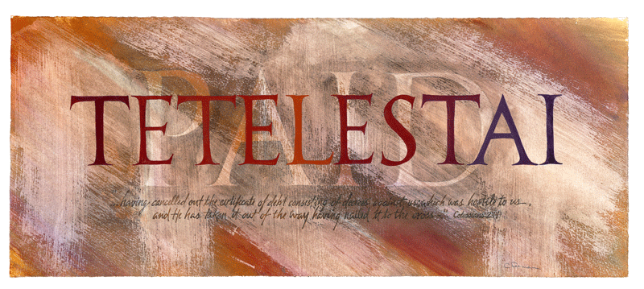

Slide 2
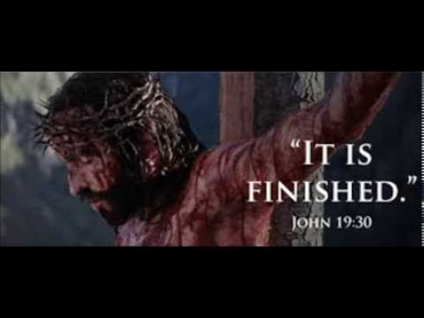
A goal achieved, a consummation, a result attained and means to bring something to a successful end to or to its intended or destined goal. It does not mean just to complete a task but to carry it out fully, to bring it to the finish or to perfection.

Slide 3
It follows that Jesus’ cry of TETELESTAI is a word of finality. The idea is “It is finished, it stands finished, and it always will be finished!” His work of redemption is complete and nothing needs to be or can be added to it.

Slide 4
It is accomplished for all time. It is the New Beginning for everything. It announces a new heaven and a new earth. The Kingdom has Come!

Slide 5
. Sin is atoned for (Heb 9:12-note, Heb 10:12-note), Satan is defeated and rendered powerless (Heb 2:14-15-note, 1Jn 3:8), every requirement of the Law has been satisfied and God’s holy wrath against sin has been satisfied (or propitiated) (Ro 3:25-note, Heb 2:17-note, 1Jn 2:2, 4:10). Redemption is eternally secured. We are reconciled in Christ's "fleshly body through death" that we might be presented before God "holy and blameless and beyond reproach."

Slide 6
. Sin is atoned for (Heb 9:12-note, Heb 10:12-note), Satan is defeated and rendered powerless (Heb 2:14-15-note, 1Jn 3:8), every requirement of the Law has been satisfied and God’s holy wrath against sin has been satisfied (or propitiated) (Ro 3:25-note, Heb 2:17-note, 1Jn 2:2, 4:10). Redemption is eternally secured. We are reconciled in Christ's "fleshly body through death" that we might be presented before God "holy and blameless and beyond reproach."

Slide 7
TETELESTAI is in the perfect tense which describes a PAST completed act with PRESENT effect, emphasizing that the past completed event of Christ's death on the Cross has ongoing, even permanent effects. Jesus’ sacrifice may have occurred in time and space, but its results will last for eternity! In other words, when Jesus declared “IT IS FINISHED”

Slide 8
TETELESTAI is in the perfect tense which describes a PAST completed act with PRESENT effect, emphasizing that the past completed event of Christ's death on the Cross has ongoing, even permanent effects. Jesus’ sacrifice may have occurred in time and space, but its results will last for eternity! In other words, when Jesus declared “IT IS FINISHED”

Slide 9
MANKIND IS REDEEMED CREATION IS RESTORED GOD'S INTENT IS FULFILLED!

Slide 10
JESUS CHRIST

Slide 11
SERVANTS

Slide 12
PRIEST

Slide 13
PRISONERS

Slide 14
MERCHANTS

Slide 15
ARTIST

Slide 16
MATHEMATICIANS

Slide 17
CONQUERING WARRIORS

Slide 18
When Jesus died on that Cross:
He bore our griefs.
He carried our sorrows.
He was wounded for our transgressions.
He was bruised for our iniquities.
He was chastised for our peace.
He was scourged for our healing.

Slide 19
This was Jesus’ exclamation that He had finished the work the Father had sent Him to do.

Slide 20
In classical Greek times, the word tetelestai depicted a turning point when one period ended and another new period began.

Slide 21
His spiritual seed shall serve him. Future generations will hear from us about the wonders of the Victorious Lord. His generation yet to be born will glorify him. And they will all declare, “It is finished!” Psalm 22:30-31

Slide 22
TAKE JESUS'S WORDS APPLY THEM TO EVERY AREA OF YOUR LIFE!

Slide 23
SIN

Slide 24
SICKNESS

Slide 25
DISEASE

Slide 26
DEATH

Slide 27
DEVIL

Slide 28
THE WORKS OF THE DEVIL

