Slide 1
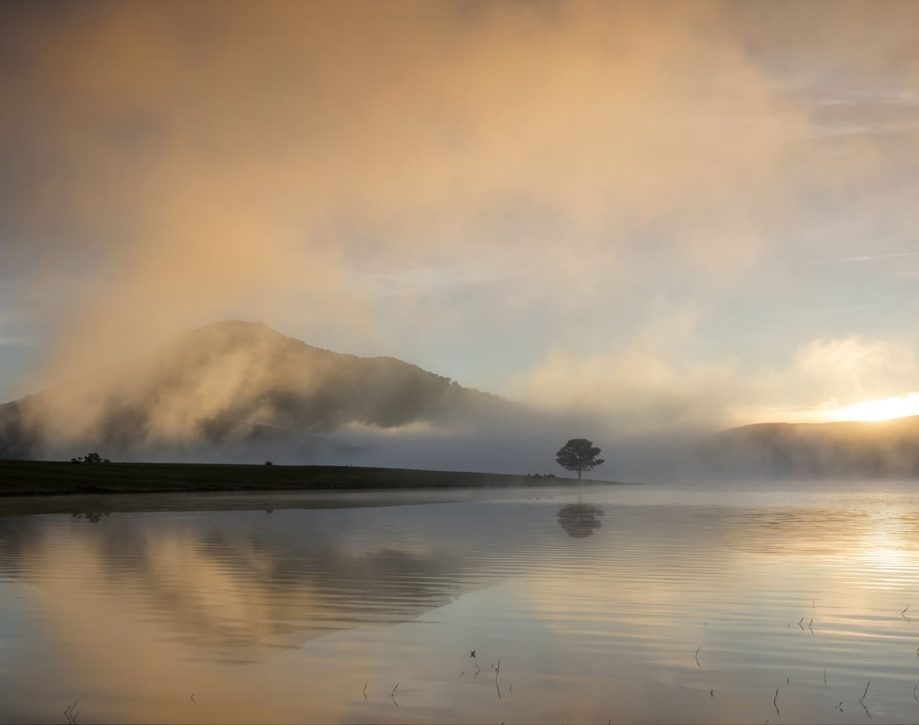
ONWARD TO OCCUPY
DEUTERONOMY 1:8
Luke 19:13

Slide 2
ONWARD:
Forward in time, order, degree.
To move forward in time, order, degree.
To move in a continuing forward direction; ahead.
Going further rather than coming to an end or halt; moving forward.
Toward a point, in the future.
BEYOND!

Slide 3
OCCUPY: To reside or have one's place, space, time.
To fill or take up (a space or time).
To be situated in or at (a place or position)
To fill or preoccupy (the mind or thoughts)
To take control of (land) by military conquest or settlement.

Slide 4
"God blessed them and said to them, "Be fruitful and increase in number; fill the earth and subdue it. Rule over the fish of the sea and the birds of the air and over every living creature that moves on the ground."
(Genesis 1:28; NIV)

Slide 5
"I will restore the fortunes of My people Israel. They will rebuild and occupy ruined cities, plant vineyards and drink their wine, make gardens and eat their produce."
(Amos 9:14; NET)

Slide 6
"Then Caleb silenced the people before Moses, saying, "Let us go up and occupy it, for we are well able to conquer it."
(Number 13:30; NET)

Slide 7
"Look! I have already given the land to you. Go, occupy the territory that I, the Lord, promised to give to your ancestors Abraham, Isaac, and Jacob, and to their descendants."
(Deuteronomy 1:8; NET)

Slide 8
" The lovers of God who chase after righteousness will find all their dreams come true: an abundant life drenched with favor and a fountain that overflows with satisfaction. ²² A warrior filled with wisdom ascends into the high place and releases regional breakthrough, bringing down the strongholds of the mighty.”
(Proverbs 20:21-22; TPT)

Slide 9
" The Lord God is my strength [my source of courage, my invincible army]; He has made my feet [steady and sure] like hinds’ feet And makes me walk [forward with spiritual confidence] on my high places [of challenge and responsibility]."
(Habakkuk 3:19; AMP)

Slide 10
"I will restore the fortunes of My people Israel. They will rebuild and occupy ruined cities, plant vineyards and drink their wine, make gardens and eat their produce."
(Amos 9:14; NET)

Slide 11
" And he called his ten servants, and delivered them ten pounds, and said unto them, Occupy till I come."
(Luke 19:13; KJV)

Slide 12
Onward, Christian soldiers! Marching as to war, Looking unto Jesus, who is gone before. Christ, the royal Master, Leads against the foe; Forward into battle, See his banners go!

Slide 13
Onward, Christian soldiers! Marching as to war, Looking unto Jesus, who is gone before.

Slide 14
At the sign of triumph, Satan's host doth flee; On, then, Christian soldiers, On to victory. Hell's foundations quiver, At the shout of praise; Brothers, lift your voices, Loud your anthems raise.

Slide 15
Onward, Christian soldiers! Marching as to war, Looking unto Jesus, who is gone before.

Slide 16
Like a mighty army, Moves the Church of God; Brothers, we are treading, Where the Saints have trod. We are not divided; All one body we: One in hope and doctrine, One in charity.

Slide 17
Onward, Christian soldiers! Marching as to war, Looking unto Jesus, who is gone before.

Slide 18
Onward, then, ye people; Join our happy throng. Blend with ours your voices, In the triumph song: Glory, laud, and honor, Unto Christ, the King. This through countless ages, Men and angels sing.

Slide 19
Onward, Christian soldiers! Marching as to war, Looking unto Jesus, who is gone before.

