Slide 1
Pey aleph

Slide 2
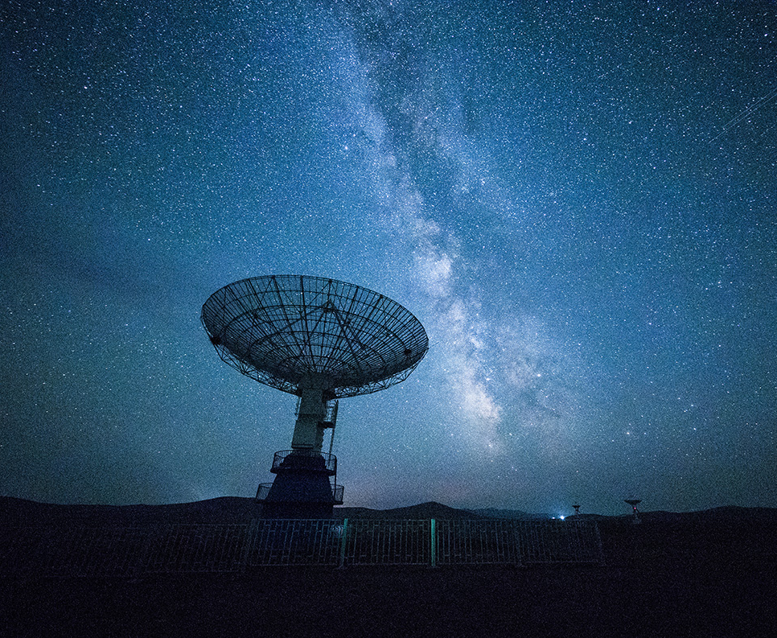
Global technology
Smart Product
Voice Recognition
Artificial Intelligence
VR

Slide 3
Uses of Virtual Reality

Slide 4
The year of the father

Slide 5
THE DECREE

