Slide 1
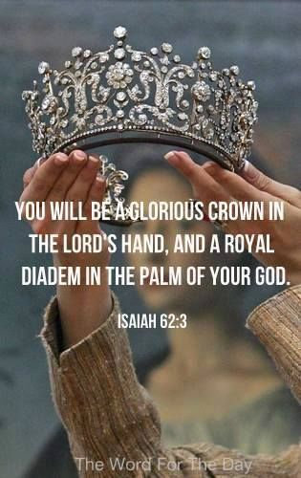
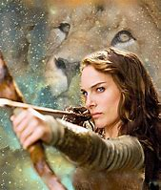

Slide 2
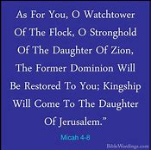
LAND
SEED
BLESSINGS
GATES…
CITIES/STATES
NATIONS
TERRITORIES… TENTS…TREASURIES…

Slide 3
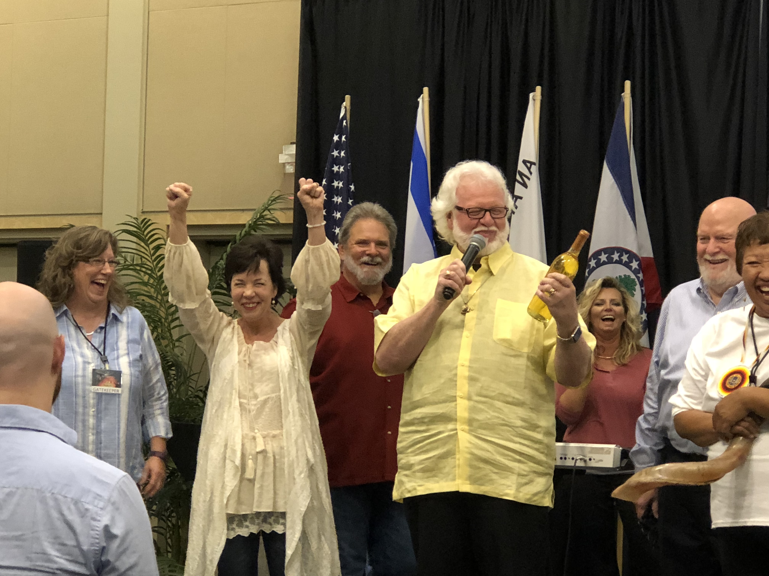
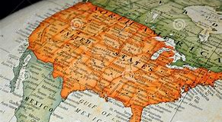
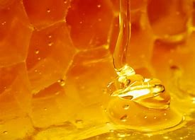
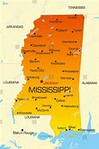
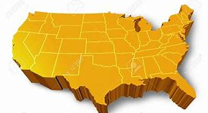
MISSISSIPPI FIRSTFRUITS STATE
MISSISSIPPI IS A FIRST FRUITS STATE… I SAW THE UNITIED STATES OF AMERICA IN THE SHAPE OF A HONEYCOMB… OUT OF MISSISSIPPI THE HONEY BEGAN TO DRIP…THE LORD SAID…
Vision of the Lord: July 2018 Betty Love

Slide 5
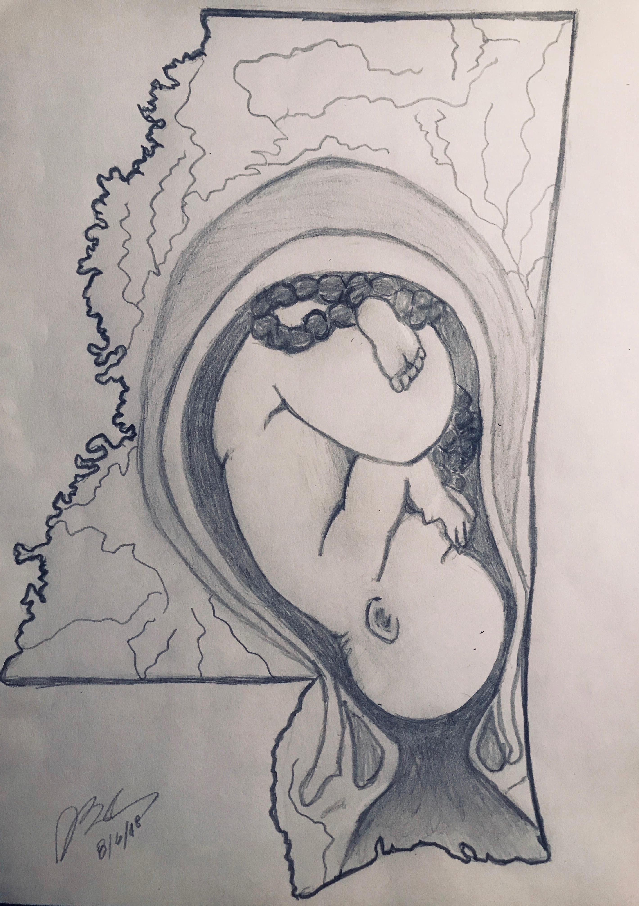
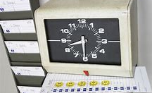
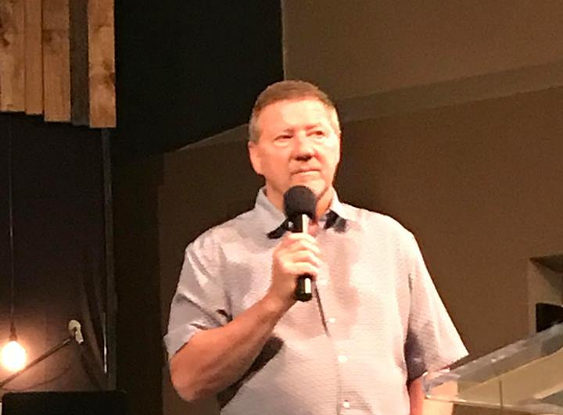
Kairos/ Fullness of Time…
THE WORSHIP
THE WEALTH
THE ABILITY TO PRODUCE WEALTH

Slide 6
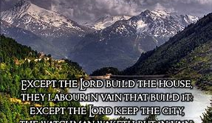
THEY WILL NOT BE PUT TO SHAME WHEN THEY CONTEND WITH THEIR ENEMIES IN THE GATE
THE LORD
BUILDS HIS HOUSE
WATCHES OVER HIS CITY
PROVIDES FOR HIS BELOVED…

Slide 8
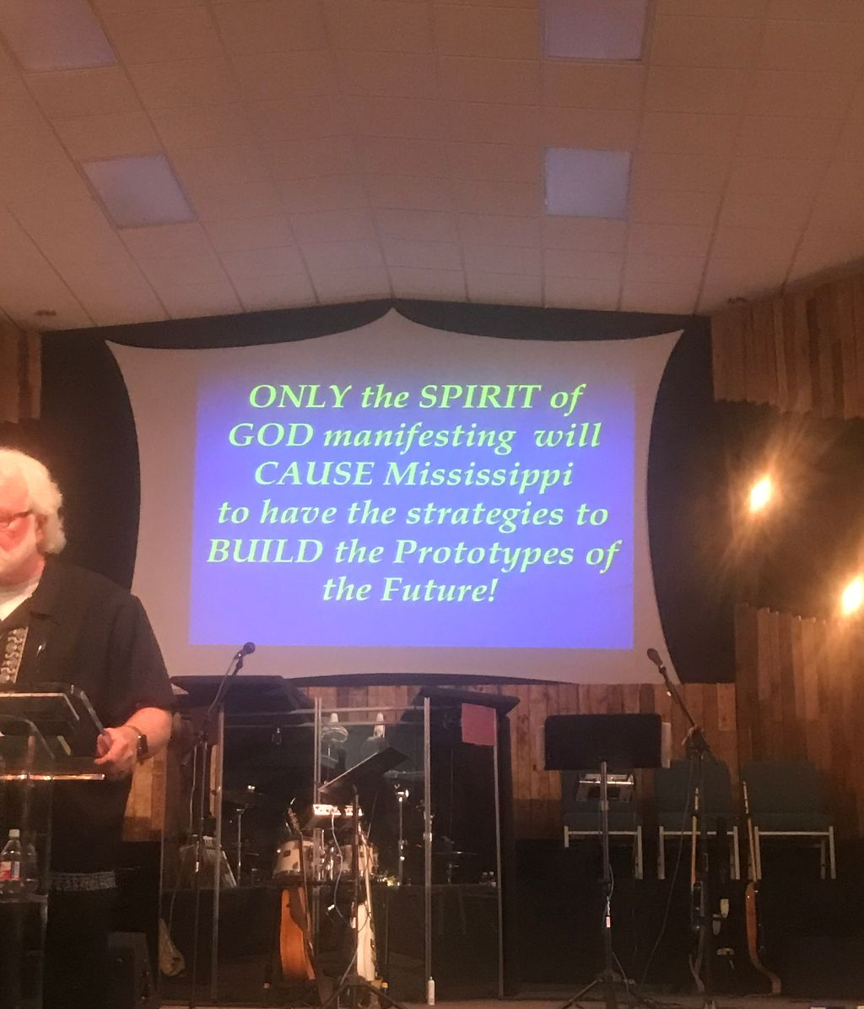
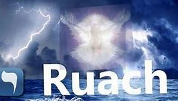
THE SPIRIT OF GOD
as an inspiring ecstatic state of prophecy
as an impelling prophet to utter instruction or a warning
imparting a war-like energy and executive and administrative power
as endowing men with various gifts
as an energy of life
the Shekinah

Slide 9
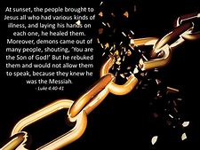
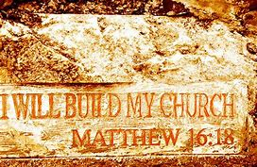
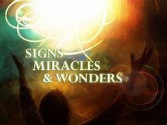
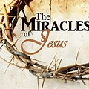
APOSTOLIC IT’S JESUS HIS MANTLE… HIS MESSAGE… HIS MINISTRY… HIS AUTHORITY… HIS ANOINTING… HIS ABILITY…
NEW ERA…NEW GLORY…

Slide 10
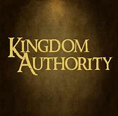
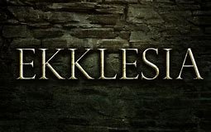
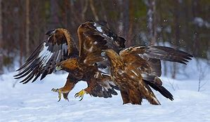
EKKLESIA: The word 'church' in the New Testament is translated from the Greek word 'ekklesia' which comes from two words 'ek' meaning 'out' and 'kaleo' meaning to 'call.' An ekklesia or 'calling out' was not just an assembly. The words agora and paneguris as well as heorte, koinon, thiasos, sunagoge and sunago can all mean an assembly.
The word ekklesia was a political term, not a religious term. Jesus was the King and the Bible used the term ekklesia for a good reason. In classical Greek "ekklesia" meant "an assembly of citizens summoned by the crier, the legislative assembly."¹
The Ekklesia is a governmental representation of the population who can operate in the courts of Heaven to secure blessings from Heaven for a city, state, nation or generation.
The Ekklesia represent the population to petition the courts of Heaven for mercy instead of judgement.
The Ekklesia will be instrumental in intercession as we secure designated land, gates, cities, territories and regions and nations for Kingdom Advancement.

Slide 11
THE IMMEDIATE…

Slide 13
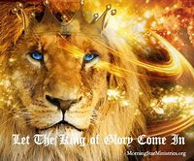
MANTLED FOR WAR
THE ROBE OF STATE: A CHANGE OF RAIMENT
to equip for war
to arm for war
to rescue
to be rescued
be equipped
to go equipped
to be armed

Slide 15
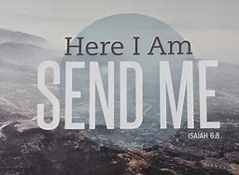
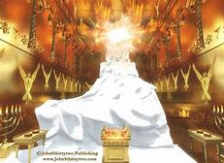
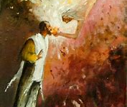
REMOVE THE INQUITY THE SEND IS UPON US!

Slide 16
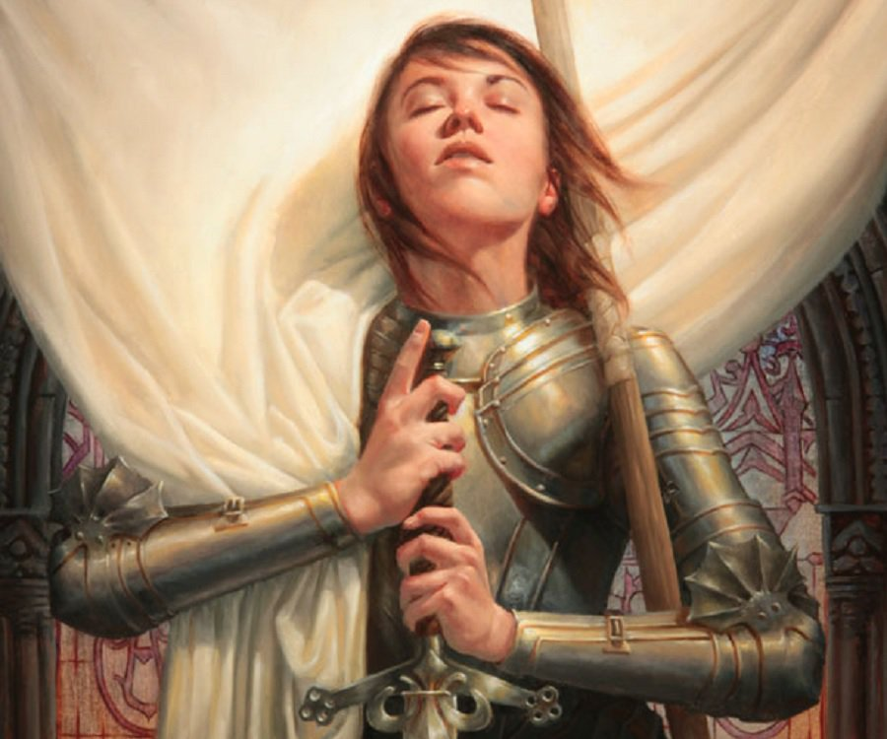
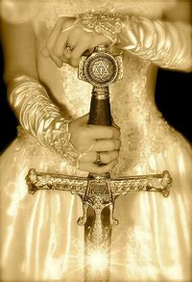
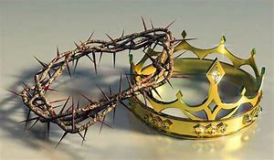

Slide 17
Hebrew 12:22-24 22 But you have come to Mount Zion, to the heavenly Jerusalem, the city of the living God. You have come to thousands upon thousands of angels in joyful assembly, 23 to the church of the firstborn, whose names are written in heaven. You have come to God, the judge of all men, to the spirits of righteous men made perfect, 24 to Jesus the mediator of a new covenant, and to the sprinkled blood that speaks a better word than the blood of Abel. NIV

Slide 18
MIRACLE CITIES MIRACLE STATE MIRACLE MISSISSIPPI MIRACLE NATION
Matthew 5:14
"You are the light of the world. A city on a hill cannot be hidden.”
Every assembly is a city – whether it ever reaches its full potential of municipality or not.
Municipality: A city, town, or other district possessing corporate existence and usually its own local government.
Matthew 5:14 "Here's another way to put it: You're here to be light, bringing out the God-colors in the world. God is not a secret to be kept. We're going public with this, as public as a city on a hill.

Slide 19
Prophetic: Impacting and empowering through encounter …Now Word…Now Worship…Now Works… a body that brings forth the Word of God, flows with the Worship of Heaven, and functions in the Works of Christ. The Supernatural…Signs, Wonders, and Miracles!
We are positioned to be a port… a portal of glory connecting the Kingdom of Heaven on Earth with a sustained corporate presence of the fullness of God that manifest and demonstrates the message of the Kingdom. His person, His presence and His power

Slide 20
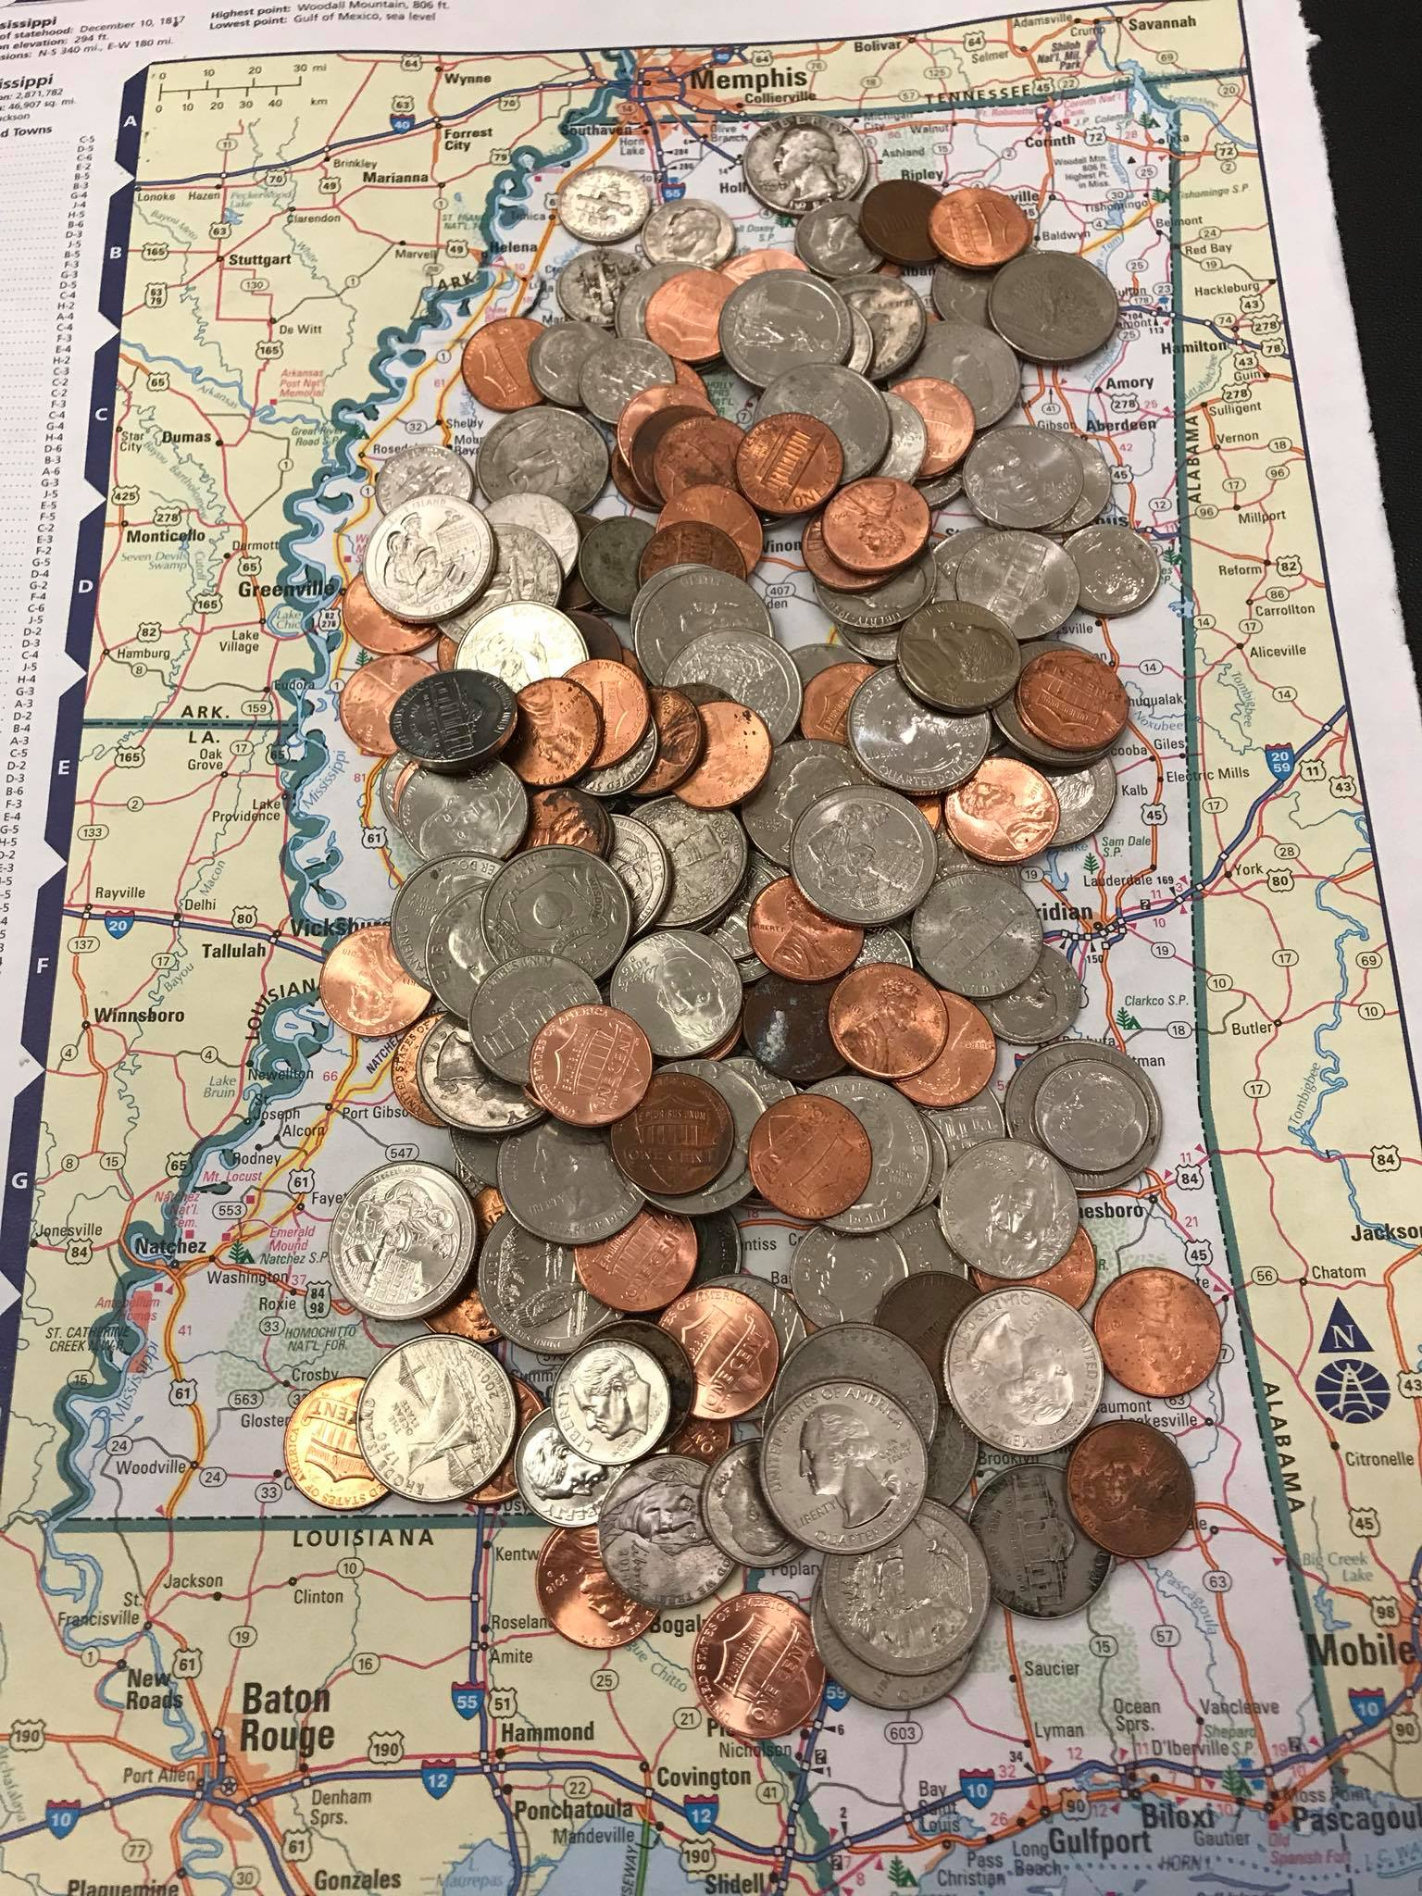
CHANGE! CHANGE! CHANGE!
A port that parents, protects, provides and promotes the culture of the Kingdom of God in individuals, the corporate assembly and community. Apostolic in leading, birthing, imparting, activating, building, aligning, teaching, training, equipping and setting things in order so that the sons of God are fully activated into their birthrights and destinies.
Strategically positioned to establish, activate, and advance the Kingdom of God on earth as it is in Heaven. (Matthew 6:10; Matthew 11:2; Romans 14:17; I Corinthians 4:20)

