Slide 1
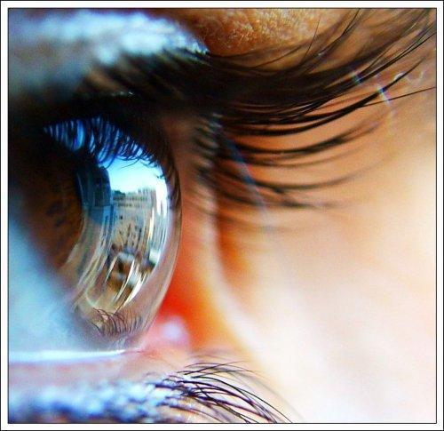
VISION: 2020

Slide 2
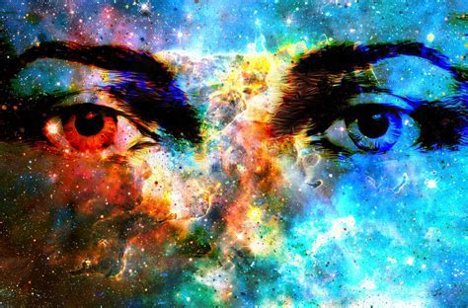
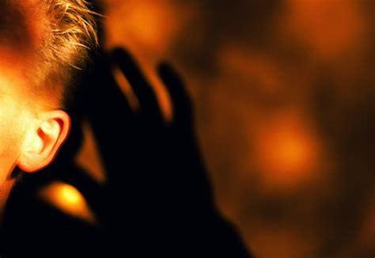
The hearing ear and the seeing eye, The [omnipotent] Lord has made both of them.
PROVERBS 20:12

Slide 3
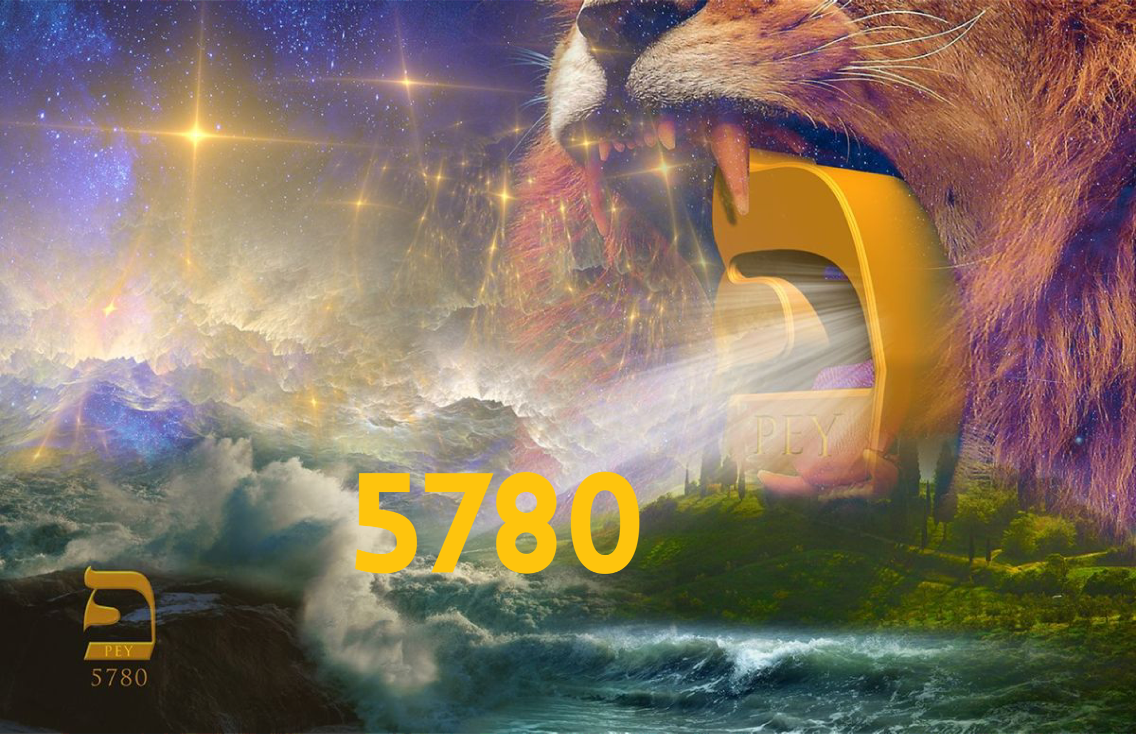

Slide 4
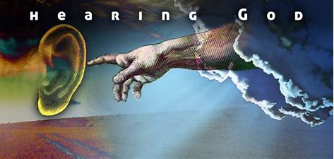
EARS THAT HEAR…

Slide 5
EYES THAT SEE…

