Slide 1
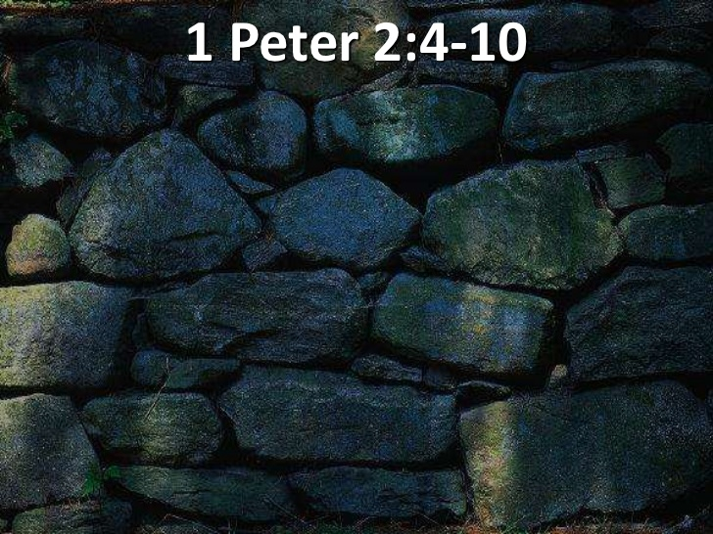
THE DECREE 2020
MIRACLE CITY GLOBAL: BUILT BY GOD…

Slide 2
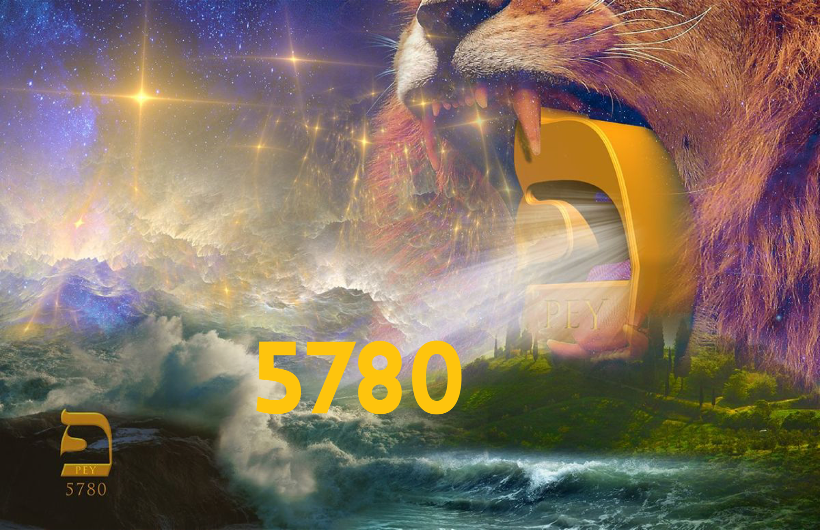

Slide 5
THE AGES ARE CONVERGING AND NOW PROPHETIC WORDS THAT ARE INFUSED WITH God assignments are intersecting their moment.
tim sheets

Slide 7
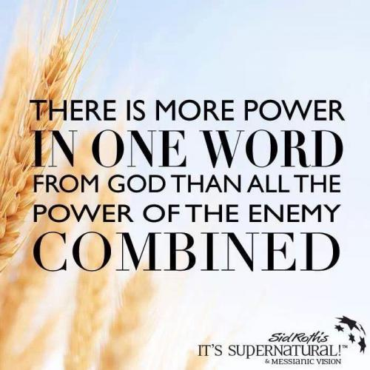
THE DECREE…
GAZAR — to cut, to divide, to cut down, to cut off, to cut in two, to snatch, to decree

Slide 8
DECREE: To judge; to divide.
1. Judicial decision, or determination of a litigated cause; as a decree of the court of chancery. The decision of a court of equity is called a decree; that of a court of law, a judgment.
2. In the civil law, a determination or judgment of the emperor on a suit between parties.
3. An edict or law made by a council for regulating any business within their jurisdiction; as the decrees of ecclesiastical councils.

Slide 9
DECREE: To judge; to divide.
4. In general, an order, edict or law made by a superior as a rule to govern inferiors.
There went a decree from Cesar Augustus, that all the world should be taxed. Luke 2.
5. Established law, or rule.
He made a decree for the rain. Job 20:28.
6. In theology, predetermined purpose of God; the purpose or determination of an immutable Being, whose plan of operations is, like himself, unchangeable.

Slide 10
THE DECREE: The predetermined purpose of God; the purpose or determination of an immutable Being, whose plan of operations is, like himself, unchangeable

Slide 11
Psalm 2:7-8 I will proclaim the decree of the Lord: He said to me, "You are my Son; today I have become your Father. 8 Ask of me, and I will make the nations your inheritance, the ends of the earth your possession.
Proverbs 8:15-16 By me kings reign, and princes decree justice. By me princes rule, and nobles, even all the judges of the earth.

Slide 12
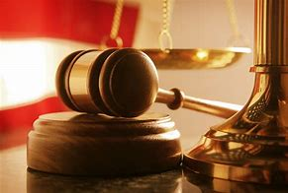
DECREE:
1. To determine judicially; to resolve by sentence; as, the court decreed that the property should be restored; or they decreed a restoration of the property.
2. To determine or resolve legislatively; to fix or appoint; to set or constitute by edict or in purpose.
Thou shalt decree a thing, and it shall be established. Job 22:28

Slide 13
CREATE IT!
LUKE 1:37
FOR NO WORD SPOKEN BY GOD GOD IS WITHOUT POWER.

Slide 14
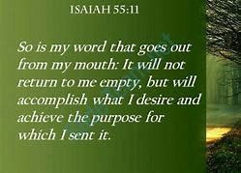
CREATE IT…
HOLY SPIRIT HOVERS…
HEAVEN RUNS…
YOUR KINGDOM COME…
YOUR WILL BE DONE…

Slide 15
CREATE IT...

