Slide 1
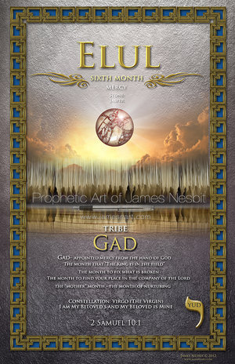

Slide 2
PSLAMS 27
1 The LORD is my light and my salvation— whom shall I fear? The LORD is the stronghold of my life— of whom shall I be afraid?
2 When the wicked advance against me to devour me, it is my enemies and my foes who will stumble and fall.
3Though an army besiege me, my heart will not fear; though war break out against me, even then I will be confident.
4 One thing I ask from the LORD, this only do I seek: that I may dwell in the house of the LORD all the days of my life, to gaze on the beauty of the LORD and to seek him in his temple.
5 For in the day of trouble he will keep me safe in his dwelling; he will hide me in the shelter of his sacred tent and set me high upon a rock.
6 Then my head will be exalted above the enemies who surround me; at his sacred tent I will sacrifice with shouts of joy; I will sing and make music to the LORD.
7 Hear my voice when I call, LORD; be merciful to me and answer me.
8 My heart says of you, “Seek his face!” Your face, LORD, I will seek.
9 Do not hide your face from me, do not turn your servant away in anger; you have been my helper. Do not reject me or forsake me, God my Savior.
10 Though my father and mother forsake me, the LORD will receive me.
11 Teach me your way, LORD; lead me in a straight path because of my oppressors.
12 Do not turn me over to the desire of my foes, for false witnesses rise up against me, spouting malicious accusations.
13 I remain confident of this: I will see the goodness of the LORD in the land of the living.
14 Wait for the LORD; be strong and take heart and wait for the LORD.

Slide 3
Elul
The sixth month of the Hebraic Calendar (The month to connect)
The month of REPENTENCE, FORGIVENESS and MERCY
The month that follows Tammuz and Av (the sin of the golden calf and the sin of the spies)
“Eye of the Needle” month

Slide 4
Characteristics
The King is in the field—Allow His countenance shine on you
Fix what has been broken (God will reveal what is fixable and the plan to do it)
Find your place in the company of the Lord
Run into the tower of might (His strength is greater than yours)
The “mother” month (month of nurturing) (Rebekah gave birth to Jacob and Esau this month)
Faith Requires Action!! (Spiritual service, organization, and management) James 1:22-25
Complex systems and issues, in your life, become manageable in this month

Slide 5
Search and Repent
Search out known battlefields (Thoughts, Mind, and Heart) (2 Cor 10:4-5) (Be sure your emotions and actions are submitted to the Lord)
Ask the Lord to reveal areas of disobedience, secret sin, idolatry, pride (See and Hear what He shows and tells you) (Psalms 139:23-24)
This is the month to REPENT and receive His MERCY and FORGIVENESS

Slide 6
Elul
Gabriel came, to Mary, with the message, of the Lord (Luke 1:26-38)
Ezekiel’s vision from the Lord (Ezekiel 8)
A call to build the House of the Lord (Haggai 1&2)
The wall was completed (Nehemiah 6:15)

Slide 7
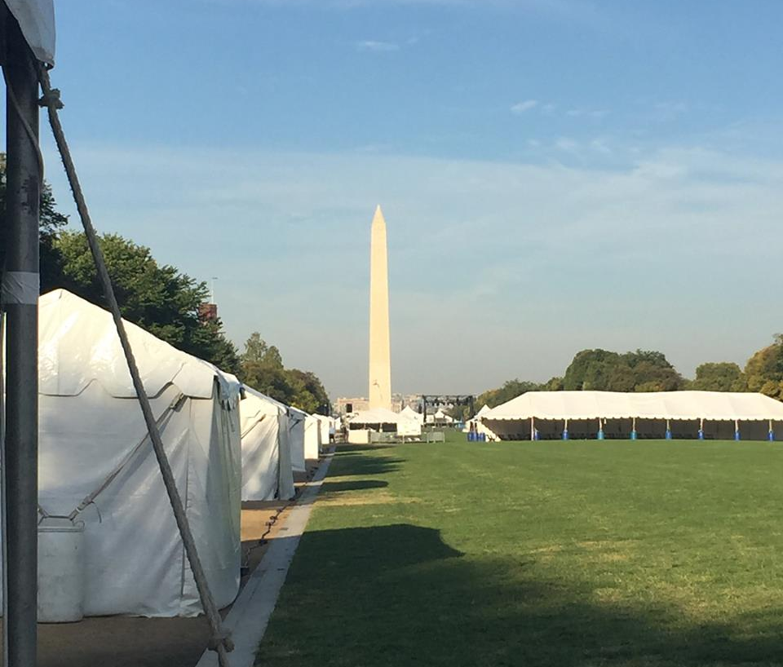
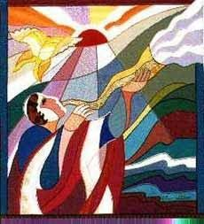
Transitioning to the fall feasts—Feast of Trumpets to the Feast of Tabernacles

Slide 8
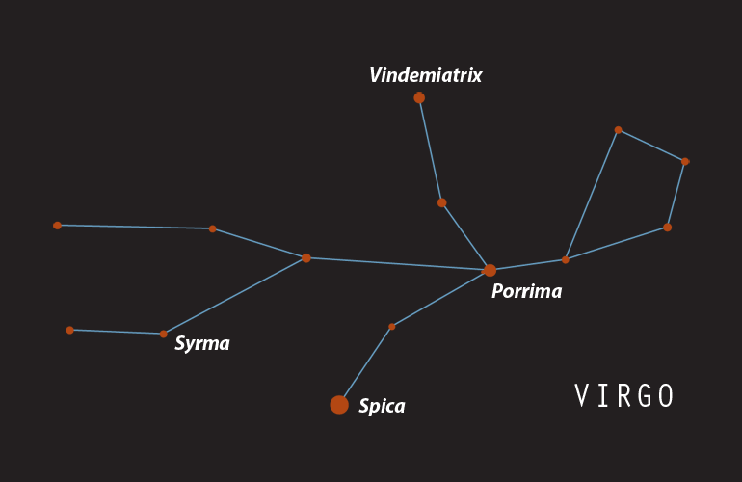
Constellation (Virgo, the Virgin)
“I am my beloved’s and my beloved is mine.” Song of Songs 6:3
Process and experience a new level of intimacy with the Lord.

Slide 9
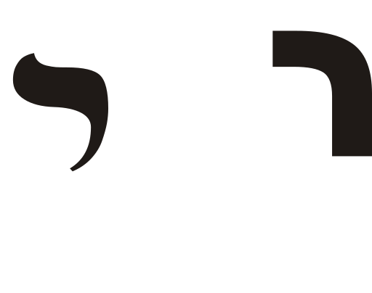
Hebrew Letter--YOD
Has a value of 10 (Order)
Picture of mercy
“God has appointed mercy from His hand”
Picture of someone bent over in humility

Slide 10
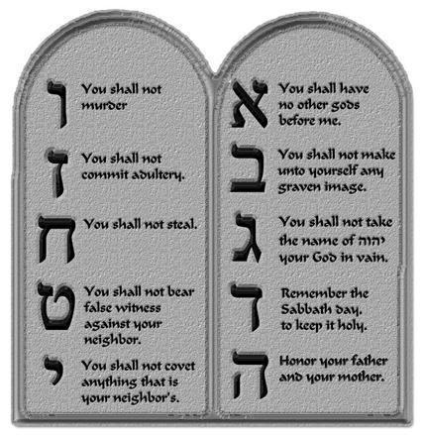
Tablets of the Covenant
God’s mercy was evident for Israel.
He gave Moses the second tablets of His Covenant to Israel.

Slide 11
The King is in the Field
This month, the King has set His Royal Tent up, in YOUR FIELD, and is there to MEET WITH YOU!!
“Come, my beloved, let us go out into the fields” Song of Songs 7:11

Slide 12
Your Field
He is making Himself accessible and surprise you with His presence
He may manifest Himself in all areas and places of your life
John 1:14—(John describes Jesus’ coming this way) “The Word became flesh and made His dwelling among us.”
The word “dwelling” is actually the word for tent or tabernacle
King Jesus left His palace and dwelt among us or tabernacle with us for 33 years.

Slide 13
Your Response
How Should You Respond?
Run to Him—The King has come to us, in OUR FIELD
Throw yourself into His arms (be lost in His embrace)
Give yourself TOTALLY to Him
Make a place for Him (does not matter the size, but just a place for Him and Him alone) EYE OF THE NEEDLE

Slide 14
Eye of the Needle Make a Place
Make a place for Him (small or large; any size)
Not a place with a “roommate” (He does not want to share space with another)
He is not asking, for you, to changes your entire life, this month
Find a place, in your life, that you can “TOTALLY” dedicate to Him, and allow Him to prove Himself, to you
Ask yourself…What Part?
(Examine your worries/cares and what has been zapping your energy and strength)

Slide 15
The Tribe of Gad
The 7th son of Jacob, but Leah’s 5th son, born through her handmaiden, Zilpah (Genesis 30:9-11)
Leah cried out “Fortunate!”(AMP) or in some translations “a coming troop!”(NKJV) when he was born
Jacob’s blessing (Genesis 49:19)
Moses’ declaration (Deut 33:20-21)
Moses granted the Tribe of Gad their inheritance before entering in the Promise Land
They established their cities first and then went to war along with the other tribes
Valiant men that are skilled in battle (1 Chron 5:18)
They were described as being fierce as lions and swift as gazelles
The least of their warriors was said to be equal to 100 others and the greatest was equal to 1,000
Gad was given an inheritance next to Zebulun (Ezekiel 48:27)
Gad is stationed at the west gate of the New Jerusalem with Asher and Naphtali (Ezekiel 48:34)

Slide 16
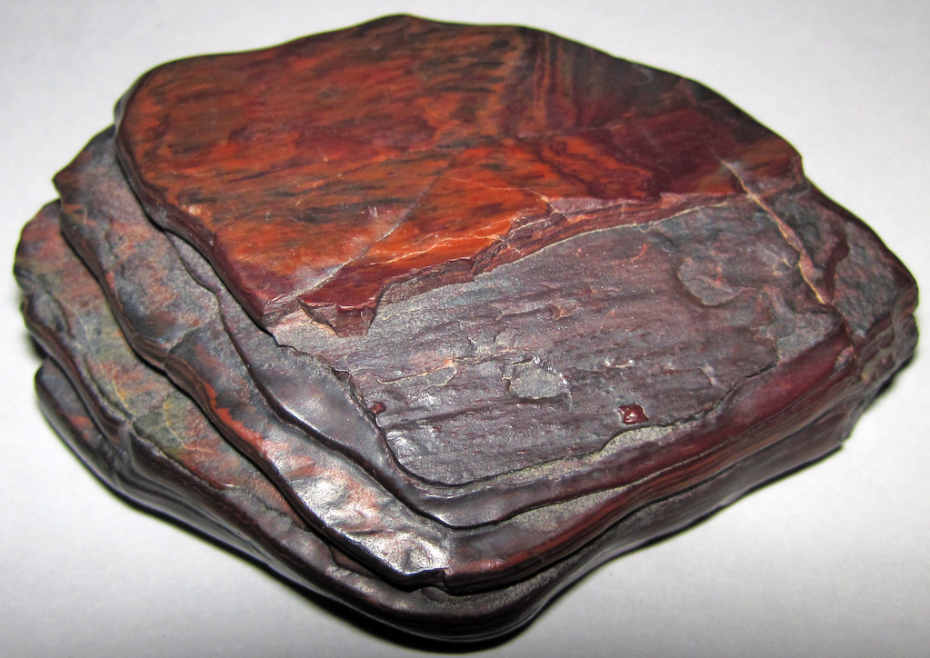
Color/Stone
Grey
Jasper/Hematite

Slide 17
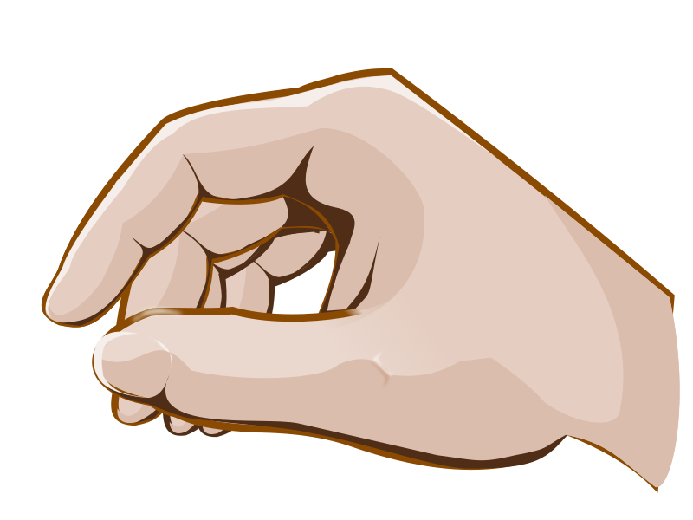
Left Hand
The body part/organ of the month
It’s a call to ACTION
To fix what is broken
(the Lord will give revelation to what is fixable and what is not)

