Slide 1
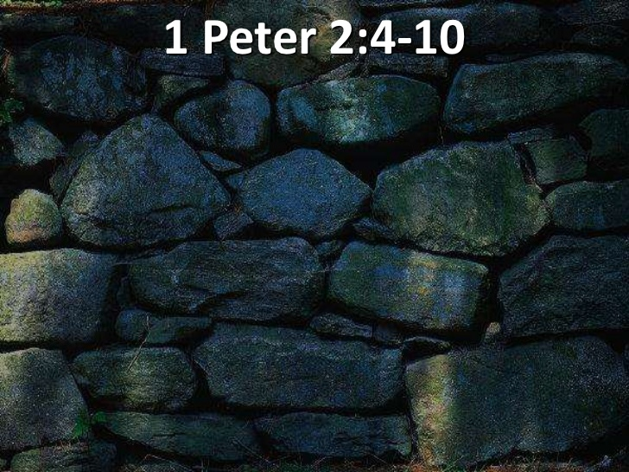
THE DECREE 2019
MIRACLE CITY GLOBAL: BUILT BY GOD…

Slide 4
THE AGES ARE CONVERGING AND NOW PROPHETIC WORDS THAT ARE INFUSED WITH God assignments are intersecting their moment.
tim sheets

Slide 6
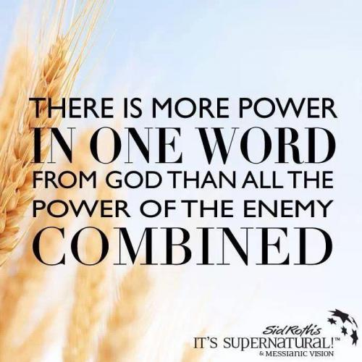
THE DECREE…
GAZAR — to cut, to divide, to cut down, to cut off, to cut in two, to snatch, to decree

Slide 7
DECREE: To judge; to divide.
1. Judicial decision, or determination of a litigated cause; as a decree of the court of chancery. The decision of a court of equity is called a decree; that of a court of law, a judgment.
2. In the civil law, a determination or judgment of the emperor on a suit between parties.
3. An edict or law made by a council for regulating any business within their jurisdiction; as the decrees of ecclesiastical councils.

Slide 8
DECREE: To judge; to divide.
4. In general, an order, edict or law made by a superior as a rule to govern inferiors.
There went a decree from Cesar Augustus, that all the world should be taxed. Luke 2.
5. Established law, or rule.
He made a decree for the rain. Job 20:28.
6. In theology, predetermined purpose of God; the purpose or determination of an immutable Being, whose plan of operations is, like himself, unchangeable.

Slide 9
THE DECREE: The predetermined purpose of God; the purpose or determination of an immutable Being, whose plan of operations is, like himself, unchangeable

Slide 10
Psalm 2:7-8 I will proclaim the decree of the Lord: He said to me, "You are my Son; today I have become your Father. 8 Ask of me, and I will make the nations your inheritance, the ends of the earth your possession.
Proverbs 8:15-16 By me kings reign, and princes decree justice. By me princes rule, and nobles, even all the judges of the earth.

Slide 11
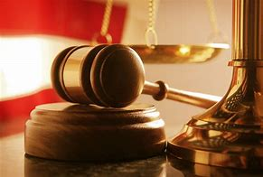
DECREE:
1. To determine judicially; to resolve by sentence; as, the court decreed that the property should be restored; or they decreed a restoration of the property.
2. To determine or resolve legislatively; to fix or appoint; to set or constitute by edict or in purpose.
Thou shalt decree a thing, and it shall be established. Job 22:28

Slide 15
CREATE IT! Psalm 104:30 When you send your Spirit, they are created, and you renew the face of the earth.

Slide 16
CREATE IT!

Slide 17
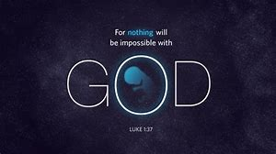
CREATE IT!
LUKE 1:37
FOR NO WORD SPOKEN BY GOD GOD IS WITHOUT POWER.

Slide 18
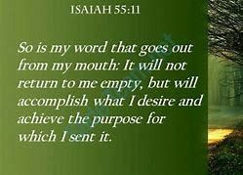
CREATE IT…
HOLY SPIRIT HOVERS…
HEAVEN RUNS…
YOUR KINGDOM COME…
YOUR WILL BE DONE…

Slide 20
ISAIAH 55:11 So will the words that come out of my mouth not come back empty-handed. They'll do the work I sent them to do, they'll complete the assignment I gave them.

Slide 21
CREATE IT...

Slide 22
Matthew 28:18‑20 Then Jesus came to them and said, “All authority in heaven and on earth has been given to me. 19 Therefore go and make disciples of all nations, baptizing them in the name of the Father and of the Son and of the Holy Spirit, 20 and teaching them to obey everything I have commanded you. And surely I am with you always, to the very end of the age."

Slide 23
Luke 10:19 I have given you authority to trample on snakes and scorpions and to overcome all the power of the enemy; nothing will harm you.

Slide 24
EXOUSIA: AUTHORITY, JURISDICTION, LIBERTY, POWER, RIGHT, STRENGTH.

Slide 25
CREATE IT…

Slide 26
ABSOLUTE AUTHORITY AUTHORITY WORKS SMART AUTHORITY HAS SENORITY AUTHORITY SPEAKS AUTHORITY SAYS

Slide 27
Mark 11:23-25 "I tell you the truth, if anyone says to this mountain, 'Go, throw yourself into the sea,' and does not doubt in his heart but believes that what he says will happen, it will be done for him. 24 Therefore I tell you, whatever you ask for in prayer, believe that you have received it, and it will be yours. 25 And when you stand praying, if you hold anything against anyone, forgive him, so that your Father in heaven may forgive you your sins."

