Slide 1
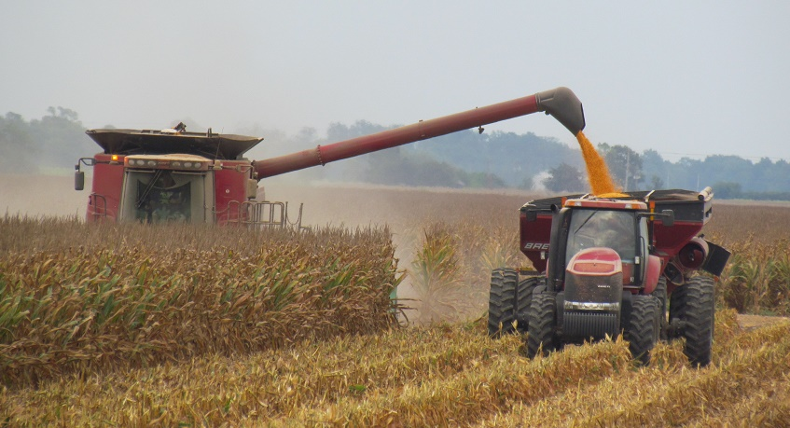
SEEDTIME AND HARVEST
The Land Recovery Act

Slide 2
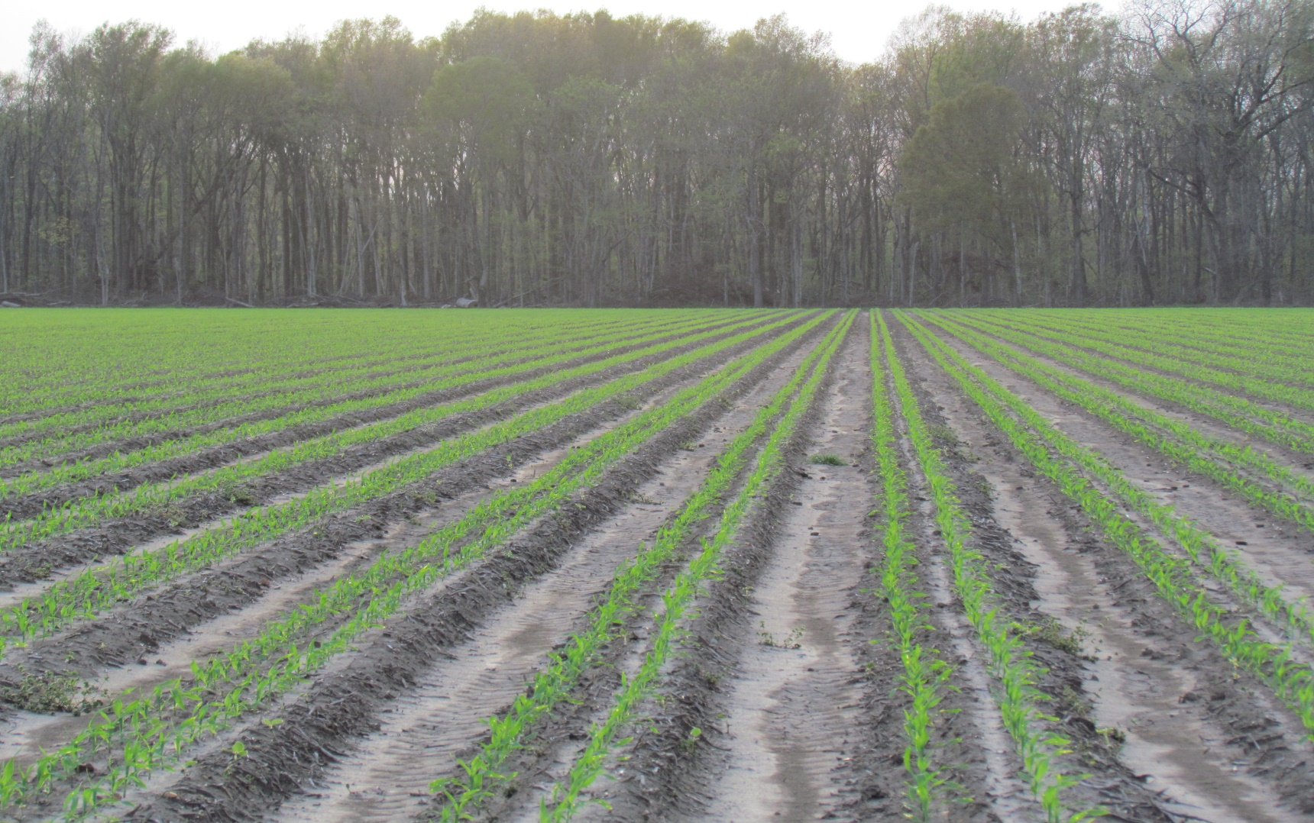
LAND, EARTH, AND GROUND
ERETS – H776 – Used 2,504x Land, earth, country, ground, the whole earth, “the land of” Israel
ADAMAH – H127 – Used 225x Land, earth, ground (as tilled, yielding sustenance), a piece of ground, a specific plot of land, earth’s visible surface

Slide 3
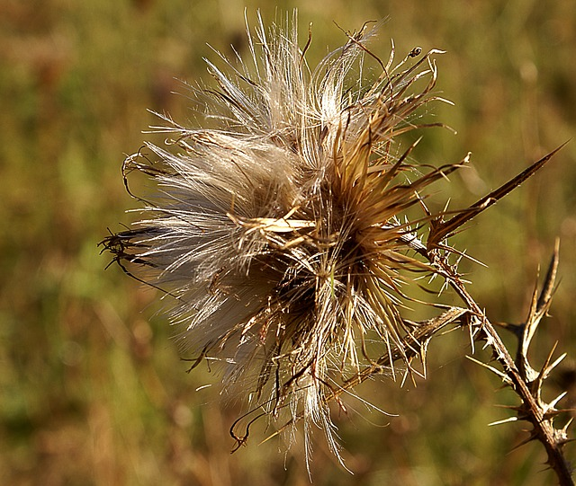
THE LAND CURSED
Genesis 1 – Have dominion
Genesis 3 – Cursed is the ground, thorns and thistles, sweat of your brow
Genesis 4 – Blood cries from the ground, will not yield its strength
Genesis 5 – Noah – “this one will comfort us”
Genesis 8 – Never again – rainbow covenant
Genesis 9 – Fear and dread of you
Genesis 10 – Nimrod and Peleg

Slide 4
ROMANS 8:19
“For the earnest expectation of the creation eagerly waits for the revealing of the sons of God. For the creation was subjected to futility, not willingly, but because of Him who subjected it in hope; because the creation itself will be delivered from the bondage of corruption into the glorious liberty of the children of God. For we know that the whole creation groans and labors with birth pangs until now.”
Beginning in 2011 and 2012, strange groaning sounds from the earth have been heard and recorded around the world. Here is a video of the earth groaning on January 20, 2012, in Germany.

Slide 5
THE LAND REDEEMED
Genesis 1:9-31
Deuteronomy 8:7 and 11:11
Psalm 98 and 107:35-38
Isaiah 32:15-17, 35, and 55:12-13
Joel 2:21-24
Zechariah 1:8-11

Slide 6
HOW TO REVERSE THE CURSE
5 KEYS TO INCREASE
Obedience to the Word –
Leviticus 26:4, Isaiah 30:21-23
The Good Shepherd –
Ezekiel 34:23-27
Praise –
Psalm 67:5-7
New Life –
Zechariah 8:12
Blessings of Revival –
Psalm 85:9-12

Slide 7
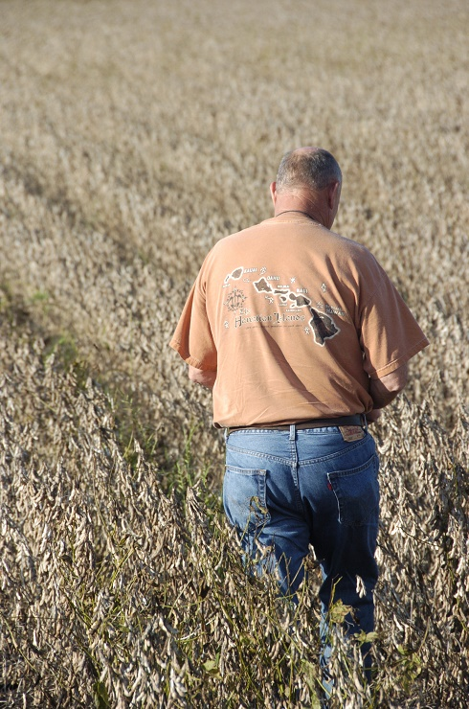
RELATIONSHIP WITH THE LORD
ADAM AND EVE
ENOCH
NOAH
ABRAHAM
ISAAC
JACOB
MOSES
DAVID

Slide 8
MANIFESTED SONS OF GOD
WHAT DOES THE LORD REQUIRE?
Deuteronomy 10:12
Isaiah 1:16-19
Ezekiel 18:5-9
Micah 6:8 – “He has shown you, O man, what is good; and what does the Lord require of you but to do justly, to love mercy, and to walk humbly with your God.”

Slide 9
MANIFESTED SONS OF GOD
IS THIS POSSIBLE?
Do Justly – Zephaniah 3:5-6
Love Mercy – Lamentations 3:22-23
Walk Humbly – John 14:16-17
John 14:26 – “But the Helper, the Holy Spirit, whom the Father will send in My Name, He will teach you all things, and bring to your remembrance all that I said to you.”

Slide 10
MANIFESTED SONS OF GOD
THE KEY – BELIEVE AND RECEIVE CHRIST JESUS AS MESSIAH
John 14:6 – “I AM the way, the truth, and the life. No man comes to the Father except through Me.”
John 1:12 – “But as many as received Him, to them He gave the right to become children of God, to those who believe in His Name…”
Romans 8:19 – “For the earnest expectation of the creation eagerly waits for the revealing of the sons of God.”

Slide 11
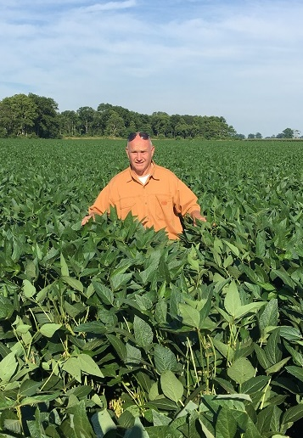
SOYBEAN INCREASE

Slide 12
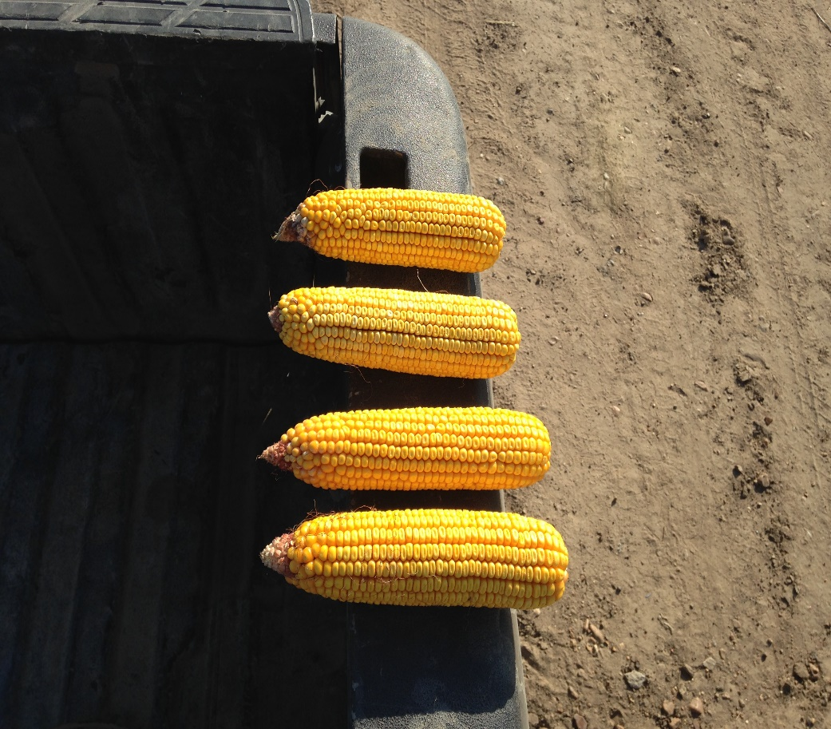
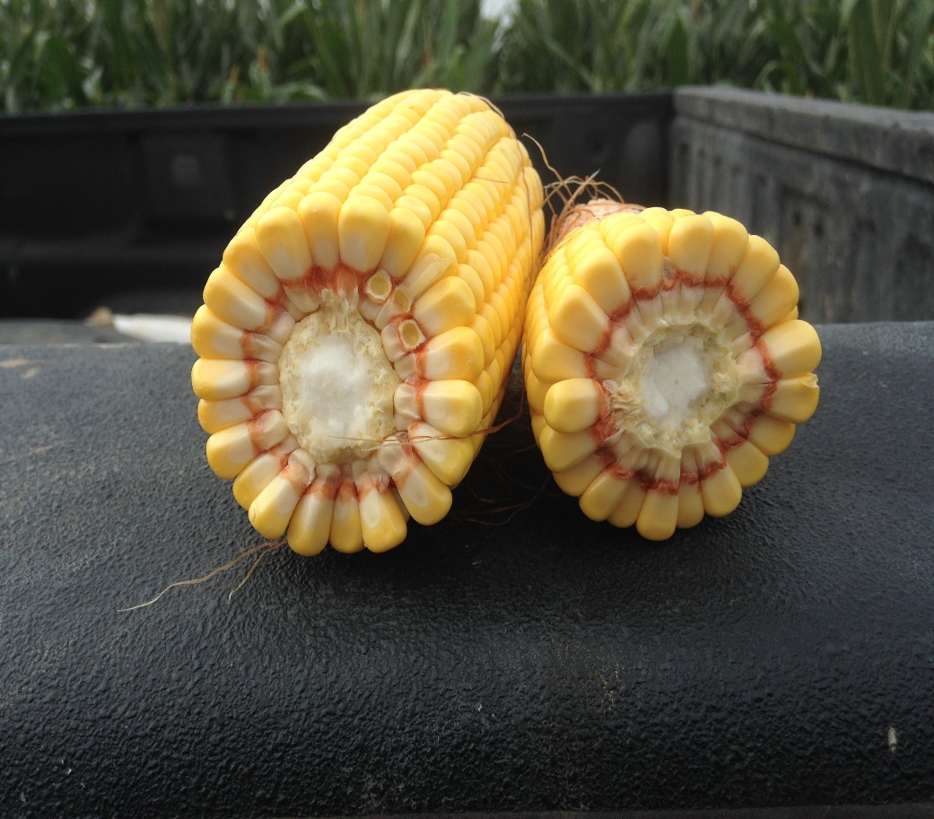
CORN INCREASE

Slide 13
IRRIGATION INCREASE
And Isaac dug again the wells of water which they had dug in the days of Abraham his father, for the Philistines had stopped them up after the death of Abraham. He called them by the names which his father had called them.
Genesis 26:18

Slide 14
ANNUAL INCREASE
Gracewood/Promise Land Yield/Acre
Year | Corn | Soybeans
2009 | 186.2 | 56.0
2010 | 176.8 | 63.2
2011 | 195.3 | 65.4
2012 | 205.1 | 60.0
2013 | 207.2 | 63.2
2014 | 210.0 | 75.0
2015 | 203.0 | 63.0
2016 | 197.0 | 62.1
2017 | 217.0 | 68.1
2018 | 218.0 | 79.0

Slide 15
THE LAND SHALL YIELD HER INCREASE

