Slide 1
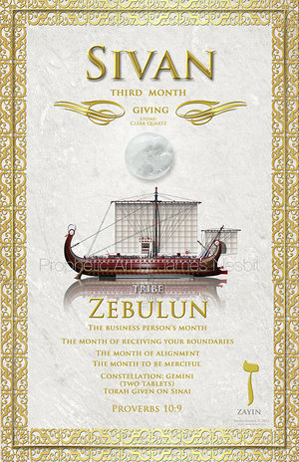

Slide 2
Characteristics
The month of Giving
The month of receiving your Boundaries
The month to be Merciful
The month of Alignment (Moses, Miriam, Aaron)
The month to connect your Talk to your Walk—making continuous, ongoing progress, in order to move, from one level of strength to the next

Slide 3
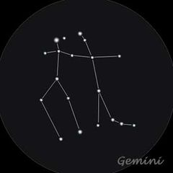
Constellation-Gemini
Gemini “2 Tablets”
Torah given on Sinai

Slide 4
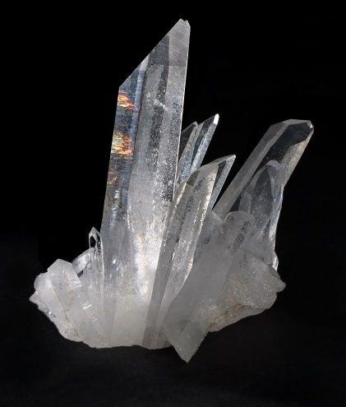
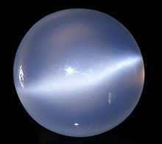
Color/Stone
Color
White/Clear
Stone
Quartz
White Moonstone

Slide 5
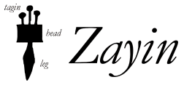
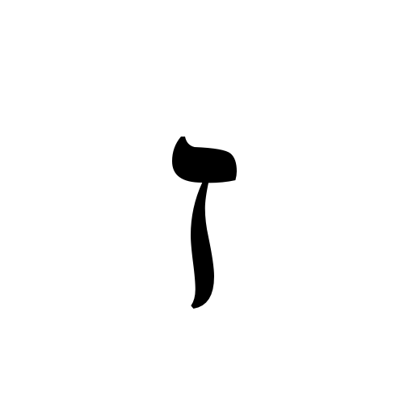
Alphabet-ZAYIN
Receiving mercy for completion

Slide 6
Sivan
The 3rd of the 12 months of the Jewish calendar
The 3rd of the 3 Spring months (Nissan, Iyar, Sivan)
The month of Pentecost (Shavuot)
The month of Jacob and Esau---The Twins

Slide 7
Sivan
Connecting your Talk to your Walk (Prov 10:9)
What you are decreeing must line up with what you are walking.
You start walking in what you decreed in the first month.
We need to connect our mouth, with our walk
Refine our emotions
Then move into God’s purpose

Slide 8
Sivan
In your physical body, this month pictures Walking and Walking means “continuous ongoing progress”
This is the month to go from one level of strength to the next

Slide 9
Sivan
Giving is a key factor in this month.
Are you giving just to be giving, or are you giving out of the revelation God has given you.
Sivan is the month and time to review your giving process and to receive new boundaries.

Slide 10
Giving
The cycle of Sowing and Reaping
A set of actions you repeat over and over again
You sow, tend your crops, and harvest….Repeat!
Sowing in good soil always leads to reaping more than you sowed.
The result---Multiplication and Increase

Slide 11
Firstfruits
Rosh Chodesh (the head of the month) is an expression of the firstfruits principle.
Deuteronomy 26---putting the first portion of the harvest in a basket and taking it to God’s sanctuary.
They honored God by giving the first of the harvest (Deuteronomy 26:19)
A major key to living in the favor and prosperity of God
The firstfruits portion, when brought to the Lord, was far less than the tithe portion of 1/10.
The smaller portion miraculously opened the door to a massive blessing
Nehemiah 10:35-39 (Firstfruits…Tithes…Offerings)

Slide 12
Sivan
This month is linked with mercy and alignment.
Israel went through testing due to Aaron and Miriam was not properly aligned with Moses.
Miriam was afflicted with leprosy and the whole camp had to stop moving for seven days (Numbers 12)
God loved Miriam and gave her the opportunity to shift into proper alignment.
Review your alignment this month!!!

Slide 13
Sivan
For those who are seeking Him, during this Shabbat month, the Feast of Weeks, the heavens are opened and the Spirit is poured out.
You receive supernatural mercy and grace to complete things.
God downloads on you exactly what is needed…Suddenly!!!

Slide 14
Sivan
There is a process to seeing clearly through the transparent pane God has placed over you.
He puts a window over you, in the first month (Nissan)
He connects, with the window, of your conscience, the next month (Iyar)
You begin to see clearly, this month (Sivan)
God is a God of order, and He knows we don’t usually understand or tap into His order immediately.

Slide 15
Sivan
Earth and heaven are connected in a timed sequence.
Don’t let your Greek mindset keep things fragmented.
God is moving through and not disconnecting the months.
Things are overlapping and tying together.
What you are experiencing one month is part of what causes you to come full circle.
You are gathering wisdom as you move forward into the fullness of God’s plan.

Slide 16
God’s Cycles
God’s cycles of life are like a spiral track.
His cycles are designed to take us from a lower level in our spiritual walk to a higher level of effectiveness and wisdom.
When entering into God’s cycles, we find ourselves going around and around, repeating the same process over and over again.
The purpose of this is not to create meaningless rituals, but to produce change and bring us to the higher level of blessings.

Slide 17
Greek Mindset
The ancient Greeks gave us a whole new way in looking at the world….the worshiping of man.
They created gods, in the form of man.
Greek Mindset---We have the power in ourselves; We are our own gods; We can make the world perfect if we all work together.
The operating principle of a Greek Mindset is PRIDE that filters through a humanistic intellect.
They believe knowledge is power, and if you have understanding, you can manipulate and control outcomes.

Slide 18
Hebrew Mindset
The opposite of the Greek Mindset is the Hebrew Mindset.
When you learn to think like God, you PROSPER.
The Hebrew Mindset operating principle is TRUSTING IN GOD.
When you understand that God has chosen you and is watching over you, you are led into a totally different way of THINKING and LIVING.
A Hebrew Mindset is the mind of one who has been transformed by the truth of God.

Slide 19
Hebrew Mindset
God took Israel and shaped their understanding and culture, to bring them into line, with His truth.
He gave them revelation of His nature.
There is only one God
He is a jealous God
He will not share His glory with idols
He is a holy, loving, and righteous God
He shaped their daily lives and taught them about holiness, as well as about holy days, holy people, and holy places.

Slide 20
Hebrew Mindset
He taught them righteousness and repentance
He divided their world into clean and unclean, to teach them about defilement of sin and what being set apart to God really means.
He introduce them to covenant and instilled in them a biblical cycle of life.
Sabbaths and feasts taught and reminded them each year of the principles of life with God.

Slide 21
Hebrew Mindset
God gave them practical wisdom for success and illustrated how to prosper and demonstrated to the world the blessing of being God’s people.
God used all of this to establish a new mindset in the earth.
Developing a Hebrew Mindset:
Meditate on God’s Word (think about, ponder, and saturate your mind with) Psalms 1 and Joshua 1
Take every thought captive (when a thought comes floating across your mind, you grab onto the thought and ask yourself……

Slide 22
Sivan
Even if we waste many years, God’s redemptive, restorative power can restore what is lost quickly.
“The years the locust has eaten will be restored” (Joel 2:25)
Once you get moving in God’s time, restoration accelerates…it will double, quadruple, or go seven times faster than your waste (21 years of waste can be recouped in 3 years)

Slide 23
Sivan
GOD CAN RESTORE ALL THAT IS LOST AND OR WASTED!!!
Don’t give up!!!
Remember the temple workers rebuilt the temple, that had been in shambles, for 70 years, in 52 days.

Slide 24
Sivan
This is the month in which you can move the strength, you gained, in the last month, into a new level (Psalms 84)

Slide 25
Sivan
This is the wedding month (Covenant Month)
Read the Song of Solomon this month

Slide 26
Pentecost (Shavuot)
One of the Appointed Times that God established in Exodus 23:14-17
God intended these feasts/times, for all of His people and for all time (not temporary)
God’s Appointed Times are designed to create a rhythm in our lives.
They align our lives with God’s timing
They sync us with the Spirit of God
The results are we are in the Right Place at the Right Time.

Slide 27
Pentecost (Shavuot)
It’s held in the 3rd month of the biblical calendar
It’s a tri-fold celebration of provision
Celebrates God’s blessing for the Wheat Harvest (that was gathered at this time of year)
Celebrates the Word (giving of the Torah on Mount Sinai)
Celebrates the Holy Spirit (the outpouring of His power in Acts 2)

Slide 28
Pentecost (Shavuot)
This is the time to bring the Firstfruits, of the harvest, to the Lord, giving thanks, to Him for His physical provision
This is the time to celebrate His revelation in His Word (Torah). The time to “fall in love with God’s Word all over again”
This is the time of celebration of the Holy Spirit. This time provides an opportunity to be refilled with the Spirit and gain new vision for fulfilling His Great Commission in the world.

Slide 29
Zebulun
The 6th son of Jacob and Leah.
His names means “A Habitation”
The root word, which means, “to dwell in an exalted fashion”
This was a tribe faithful to the Lord (not associated with the massacre of Shechem, selling Joseph into slavery, or in any of the rebellions in the wilderness)
The tribe fought along Deborah and Gideon
Elon, the Zebulunite, judged Israel for 10 years
50,000 men, from Zebulun, came and helped David in Hebron. They served him “with an undivided heart”

Slide 30
Zebulun
Jacob’s Blessing (Gen 49:13)
“Zebulun will live by the seashore and become a haven for ships. His border will extend toward Sidon”
Moses’ Blessing (Deut 33:18)
“Rejoice, Zebulun, in your going out, and you, Issachar, in your tents. They will summon peoples to the mountain and there offer the sacrifices of the righteous; they will feast on the abundance, of the seas, on the treasures hidden in the sand.”

Slide 31
Zebulun
The tribe is linked with bestowing blessing
They had the ability to break iniquity off of trade structures and multiply
They can overturn corruption and greed through righteousness and godly trade systems
They developed and filled storehouses for provision
They were loyal and had their “act together”
They knew who they were and to whom they were connected to

