Slide 1

The FINEST HOUR
HISTORY UNFOLDING

Slide 2
2 Chronicles 20:15
This is what the Lord says to you: ‘Do not be afraid or discouraged because of this vast army. For the battle is not yours, but God’s.

Slide 3
1 John 2:18 (NIV)
¹⁸ Dear children, this is the last hour; and as you have heard that the antichrist is coming, even now many antichrists have come. This is how we know it is the last hour.

Slide 4
Romans 1:24-25 (MSG)
²⁴⁻²⁵ So God said, in effect, “If that’s what you want, that’s what you get.” It wasn’t long before they were living in a pigpen, smeared with filth, filthy inside and out. And all this because they traded the true God for a fake god, and worshiped the god they made instead of the God who made them—the God we bless, the God who blesses us. Oh, yes!

Slide 5
Romans 1:26-27 (MSG)
²⁶⁻²⁷ Worse followed. Refusing to know God, they soon didn’t know how to be human either—women didn’t know how to be women, men didn’t know how to be men. Sexually confused, they abused and defiled one another, women with women, men with men—all lust, no love. And then they paid for it, oh, how they paid for it—emptied of God and love, godless and loveless wretches.

Slide 6
Romans 1:28-32 (MSG)
²⁸⁻³² Since they didn’t bother to acknowledge God, God quit bothering them and let them run loose. And then all hell broke loose: rampant evil, grabbing and grasping, vicious backstabbing. They made life hell on earth with their envy, wanton killing, bickering, and cheating. Look at them: mean-spirited, venomous, fork-tongued God-bashers. Bullies, swaggerers, insufferable windbags! They keep inventing new ways of wrecking lives. They ditch their parents when they get in the way. Stupid, slimy, cruel, cold-blooded. And it’s not as if they don’t know better. They know perfectly well they’re spitting in God’s face. And they don’t care—worse, they hand out prizes to those who do the worst things best!

Slide 7
Isaiah 60:2 (NIV)
² See, darkness covers the earth
and thick darkness is over the peoples…

Slide 8
WAR
The United States of America is in the greatest moral crisis in history…. We are in a war like no other. Yet, it is backed by the same vile spirit of wickedness that you see throughout the ages. What America does in the days ahead will not only determine the outcome of our nation, but the world as we know it.

Slide 9
The FINEST HOUR
HISTORY UNFOLDING

Slide 10
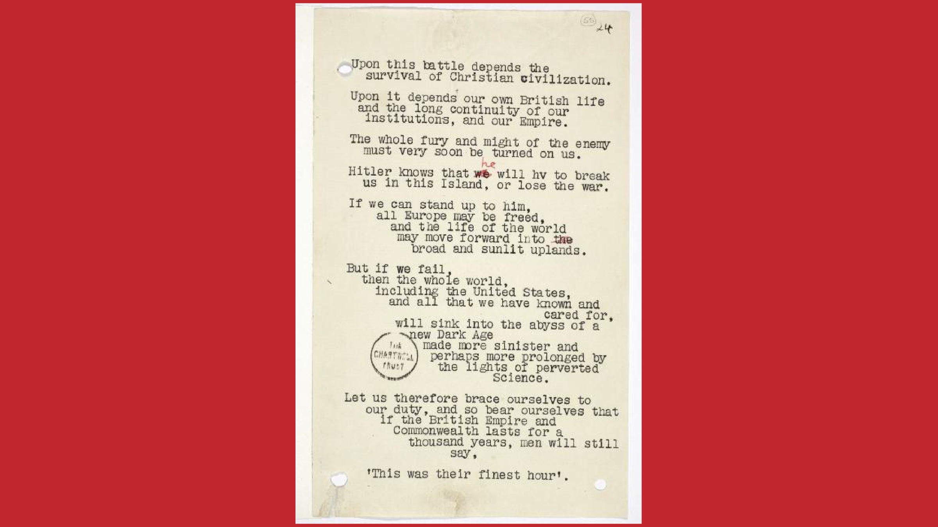

Slide 11
Proverbs 14:34
³⁴ Righteousness exalts a nation…

Slide 12
BUT….. Isaiah 60:2-3 (NIV)
² See, darkness covers the earth
and thick darkness is over the peoples, but the Lord rises upon you
and his glory appears over you.
³ Nations will come to your light,
and kings to the brightness of your dawn.

Slide 13
Isaiah 37:31-32 (NIV)
³¹ Once more a remnant of the kingdom of Judah
will take root below and bear fruit above.
³² For out of Jerusalem will come a remnant,
and out of Mount Zion a band of survivors.
The zeal of the Lord Almighty
will accomplish this.

Slide 14
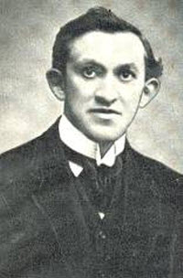
Rees Howells (1879-1950)
“I want to know that the Holy Spirit is stronger than the devil in the Nazi system. This is the battle of the ages, and victory here means victory for millions of people.” –Rees Howells

Slide 15
Matt Locket on Rees Howells
“This quote, taken from the journals of Rees Howells during World War II, captures an uncommon faith, prayer life and vision that the church desperately needs to rediscover today. God used Mr. Howells and the young people with him at the Bible College of Wales in a mighty way to shape international events and the destiny of nations through their prayers. The world was in crisis, and this company of faith-filled believers became intercessors fully committed to be part of the solution.” www.jhopdc.com

Slide 16
2 Chronicle 16:9 (NIV)
⁹ For the eyes of the Lord range throughout the earth to strengthen those whose hearts are fully committed to him.

Slide 17
Esther 4:14 (AMP)
¹⁴ For if you remain silent at this time, liberation and rescue will arise for the Jews from another place, and you and your father’s house will perish [since you did not help when you had the chance]. And who knows whether you have attained royalty for such a time as this [and for this very purpose]?”

Slide 18
Finest Hour
Time of one’s greatest achievement.
A point in time or a relatively brief period of time when an especially distinguished, admirable, or effective set of actions is performed.
Period in a persons life where he/she does his/her noblest deeds in life. Used especially in World War I and II, where thousands of soldiers answered their call of duty to their country.

Slide 19
The Finest Hour
This is your moment. We are in a time where prophetic words, dreams, visons, and the like are coming into their fullness of time.
This is your moment! Your defining moment…
What you were made for.
We are in a time to fulfill destiny and what is written in the books in heaven about us – individually, corporately, and as a nation.

Slide 20
There is a Call.. There is a Price..
Keys: Submission, Surrender, and Sacrifice.
James 4:7 (NIV) Submit yourselves, then, to God. Resist the devil, and he will flee from you.
Job 11:13-15 (CEV) ¹³ Surrender your heart to God, turn to him in prayer, ¹⁴ and give up your sins—even those you do in secret. ¹⁵ Then you won’t be ashamed; you will be confident and fearless.
Hebrews 13:15 (NLT) Therefore, let us offer a continual sacrifice of praise to God, proclaiming our allegiance to His name.

Slide 21
Psalm 5:3 (TPT)
³ At each and every sunrise you will hear my voice
as I prepare my sacrifice of prayer to you.
Every morning I lay out the pieces of my life on the altar
and wait for your fire to fall upon my heart.

Slide 22
Psalm 5:4-6 (TPT)
⁴ I know that you, God, are never pleased with lawlessness,
and evil ones will never be invited as guests in your house.
⁵ Boasters collapse, unable to survive your scrutiny,
for your hatred of evildoers is clear.
⁶ You will make an end of all those who lie.
How you hate their hypocrisy and despise all who love violence!

Slide 23
Psalm 5:7-8 (TPT)
⁷ But I know that you will welcome me into your house,
for I am covered by your covenant of mercy and love.
So I come to your sanctuary with deepest awe to bow in worship and adore you. ⁸ Yahweh, lead me in the pathways of your pleasure
just like you promised me you would, or else my enemies will conquer me. Smooth out your road in front of me,
straight and level so that I will know where to walk.

Slide 24
Amos 9:11-12 (NIV)
¹¹ “In that day
“I will restore David’s fallen shelter—
I will repair its broken walls
and restore its ruins—
and will rebuild it as it used to be,
¹² so that they may possess the remnant of Edom
and all the nations that bear my name,”
declares the Lord, who will do these things.

Slide 25
Amos 9:13-14 (NIV)
¹³ “The days are coming,” declares the Lord,
“when the reaper will be overtaken by the plowman
and the planter by the one treading grapes.
New wine will drip from the mountains
and flow from all the hills,
¹⁴ and I will bring my people Israel back from exile.

Slide 26
Amos 11:14-15 (NIV)
“They will rebuild the ruined cities and live in them.
They will plant vineyards and drink their wine;
they will make gardens and eat their fruit.
¹⁵ I will plant Israel in their own land,
never again to be uprooted
from the land I have given them,”
says the Lord your God.

