Slide 1
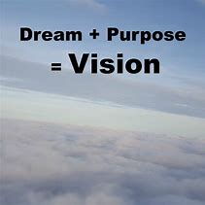
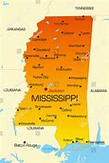
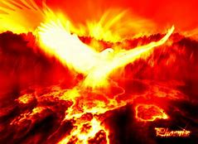
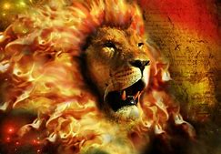
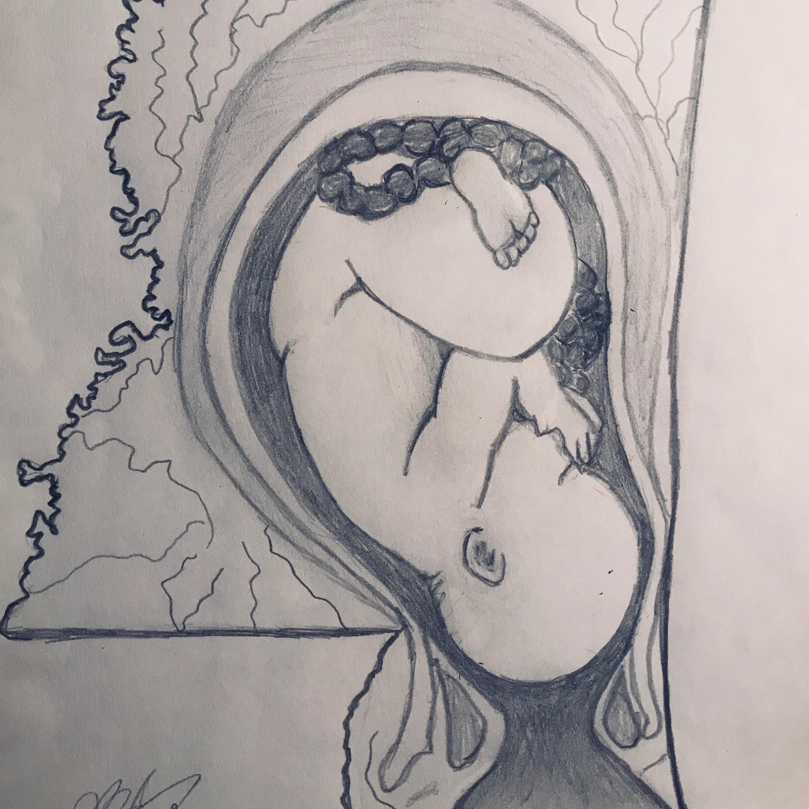
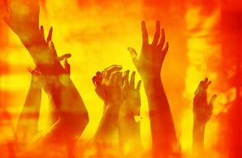
MISSISSIPPI NEEDS YOU!

Slide 2
PSALM 92 It’s so enjoyable to come before you with uncontainable praises spilling from our hearts! How we love to sing our praises over and over to you, to the matchless God, high and exalted over all! At each and every sunrise we will be thanking you for your kindness and your love. As the sun sets and all through the night, we will keep proclaiming, “You are so faithful!” ³ Melodies of praise will fill the air as every musical instrument, joined with every heart, overflows with worship. ⁴ No wonder I’m so glad; I can’t keep it in! Lord, I’m shouting with glee over all you’ve done, for all you’ve done for me!

Slide 3
^{PSALM 92:5-9}
⁵ What mighty miracles and your power at work, just to name a few. Depths of purpose and layers of meaning saturate everything you do. ⁶ Such amazing mysteries found within every miracle that nearly everyone seems to miss. Those with no discernment can never really discover the deep and glorious secrets hidden in your ways. ⁷ It’s true the wicked flourish, but only for a moment, foolishly forgetting their destiny with death, that they will all one day be destroyed forevermore. ⁸ But you, O Lord, are exalted forever in the highest place of endless glory, ⁹ while all your opponents, the workers of wickedness, will all perish, forever separated from you.

Slide 4
PSALM 92:10-11
¹⁰ Your anointing has made me strong and mighty. You’ve empowered my life for triumph^{[c]} by pouring fresh oil over me. ¹¹ You’ve said that those lying in wait to pounce on me would be defeated, and now it’s happened right in front of my eyes and I’ve heard their cries of surrender!

Slide 5
PSALM 92:12-15-
¹² Yes! Look how you’ve made all your lovers to flourish like palm trees, each one growing in victory, standing with strength! ¹³ You’ve transplanted them into your heavenly courtyard, where they are thriving before you. ¹⁴ For in your presence they will still overflow and be anointed. Even in their old age they will stay fresh, bearing luscious fruit and abiding faithfully. ¹⁵ Listen to them! With pleasure they still proclaim: “You’re so good! You’re my beautiful strength! You’ve never made a mistake with me.”

Slide 6
MISSISSIPPI NEEDS YOU!

Slide 7
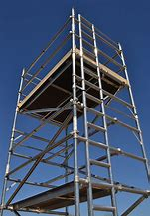
THE WATCH TOWER
A SHELTER OR REFUGE THAT AFFORDED AN EXTENSIVE VIEW FOR THE WATCHMEN.
SAFETY
PROVISION
STRENGTH
HIGH HOPES OR ASPIRATIONS
PLACE OF OBSERVATION
TO RISE ABOVE SITUATIONS

Slide 8
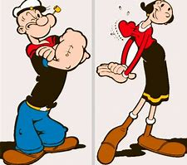
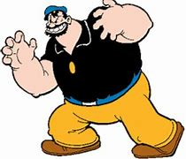
THE MIGHTY ARM...
Isaiah 61:8-9
8 "For I, the Lord, love justice;
I hate robbery and iniquity.
In my faithfulness I will reward them
and make an everlasting covenant with them.
9 Their descendants will be known among the nations
and their offspring among the peoples.
All who see them will acknowledge
that they are a people the Lord has blessed."

Slide 9
Psalm 89:13 Your arm is endued with power; your hand is strong, your right hand exalted. NIV
Psalm 77:15 With your mighty arm you redeemed your people, the descendants of Jacob and Joseph.

Slide 10
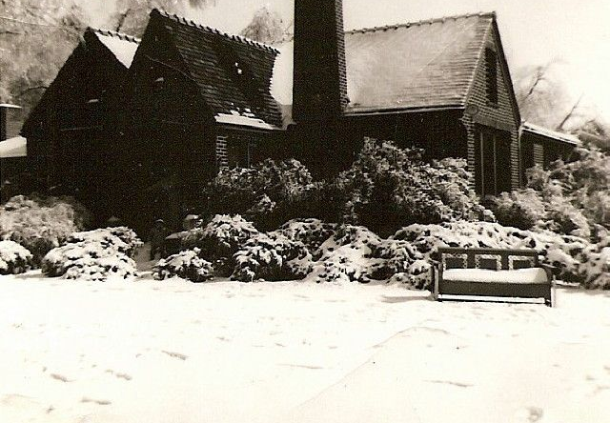
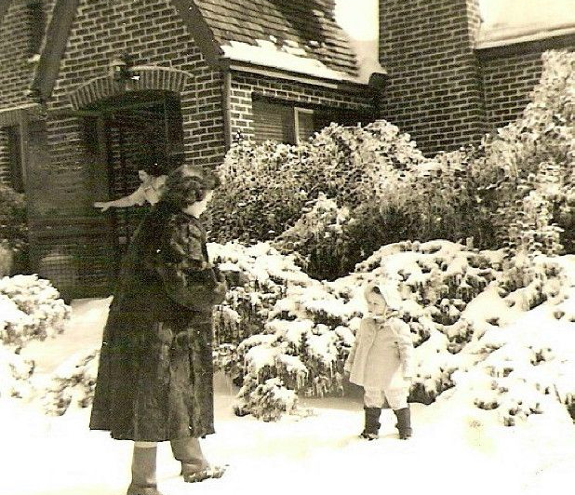
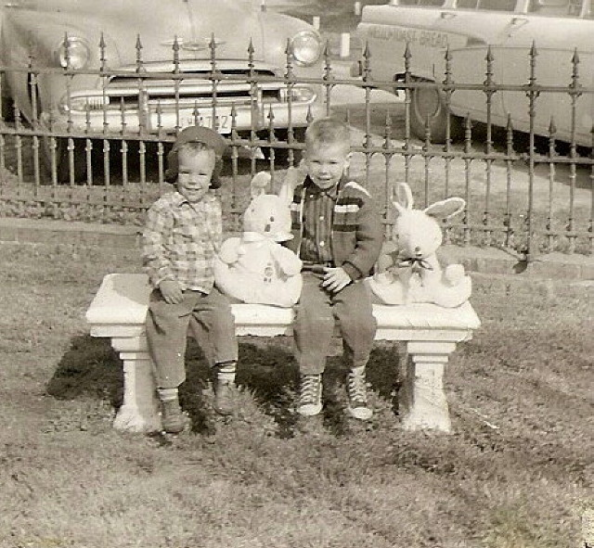
VICTORY…
FULL CIRCLE….
ORIGINAL INTENT…
INHERITANCE…
GOING BACK TO YOUR ROOTS TO RECOVER ALL.
THE LORD IS BRINGING YOU INTO YOU BIRTHRIGHT AND DESTINY

Slide 11
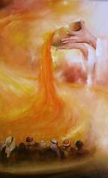
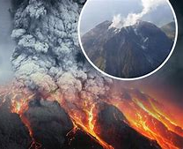
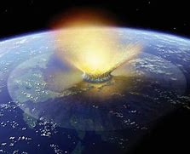
VOLCANO ERUPTION…
“I can feel it coming in the air tonight, oh Lord And I've been waiting for this moment for all my life, oh Lord Can you feel it coming in the air tonight, oh Lord, oh Lord”

Slide 12
TRANSFORMATION FIRE IS COMING…
VOLCANO
AN ERUPTION FROM GREAT PRESSURE THAT RELEASES THE REVIVAL FIRES OF GOD TO FLOW.
A GREAT TRANFORMING FIRE.

Slide 13
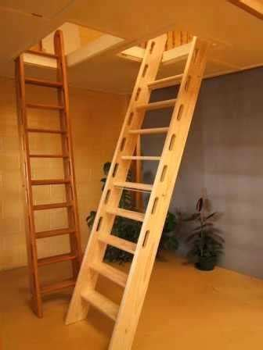

Slide 14
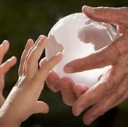
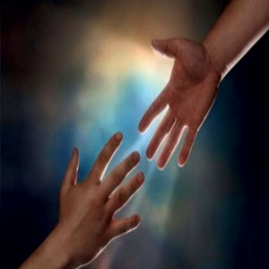
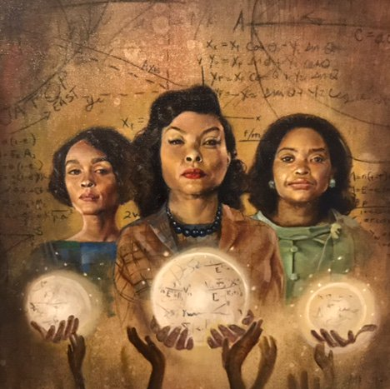
RECOVERING ALL…

Slide 15
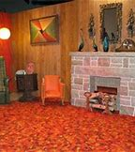
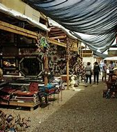
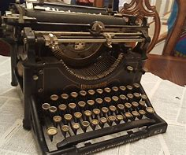
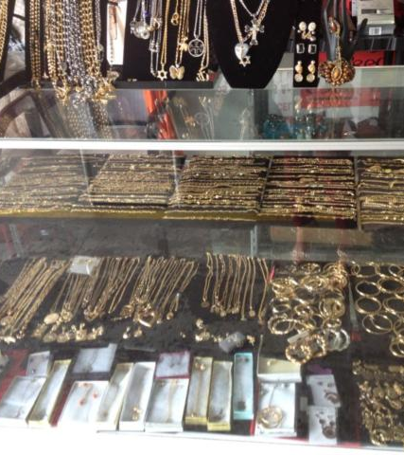
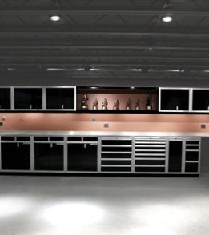
FULL RECOVERY…

Slide 16
THE ANOINTING… THE INHERITANCE
PSALM 92:10-11
¹⁰ Your anointing has made me strong and mighty. You’ve empowered my life for triumph^{[c]} by pouring fresh oil over me. ¹¹ You’ve said that those lying in wait to pounce on me would be defeated, and now it’s happened right in front of my eyes and I’ve heard their cries of surrender!

Slide 17
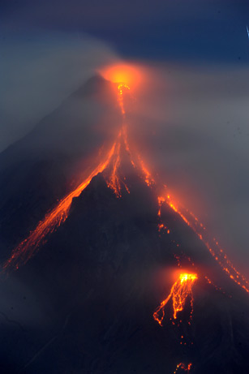
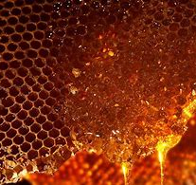
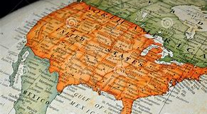
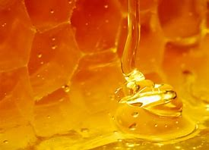
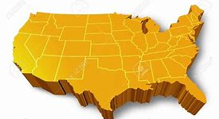
MISSISSIPPI FIRSTFRUITS STATE
MISSISSIPPI IS A FIRST FRUITS STATE… I SAW THE UNITIED STATES OF AMERICA IN THE SHAPE OF A HONEYCOMB… OUT OF MISSISSIPPI THE HONEY BEGAN TO DRIP…THE LORD SAID…
Vision of the Lord: July 2018 Betty Love

Slide 18
THE WATCH TOWER
A SHELTER OR REFUGE THAT AFFORDED AN EXTENSIVE VIEW FOR THE WATCHMEN.
SAFETY
PROVISION
STRENGTH
HIGH HOPES OR ASPIRATIONS
PLACE OF OBSERVATION
TO RISE ABOVE SITUATIONS

Slide 19
MISSISSIPPI FIRSTFRUITS STATE
MISSISSIPPI…
“PEOPLE ARE GOING TO COME TO MISSISSIPPI TO WATCH THE NATION…”

Slide 20
MISSISSIPPI FIRSTFRUITS STATE
MISSISSIPPI…
“AS GOES GOD SO GOES MISSISSIPPI…”

Slide 21
MISSISSIPPI FIRSTFRUITS STATE
MISSISSIPPI…
“MISSISSIPPI KNOWS NO BOUNDS…NO LIMITS”

Slide 22
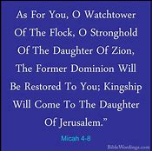
LAND
SEED
BLESSINGS
GATES…
CITIES/STATES
NATIONS
TERRITORIES… TENTS…TREASURIES…

Slide 24
PROPHETIC DESTINY… AWAKENING…OUTPOURING…

