Slide 1
KISLEV

Slide 2
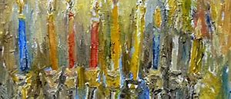
KISLEV
OT:3691 Kislev — Chisleu
“His Confidence"
The 9th month of the calendar corresponding to our November-December

Slide 3
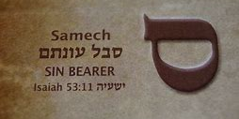
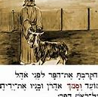
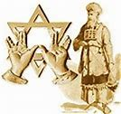
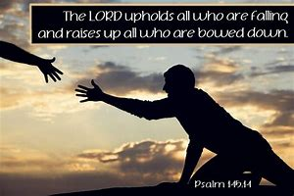
SAMEKH
TRUST
SUPPORT
COMING FULL CIRCLE

Slide 4
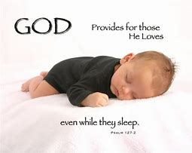
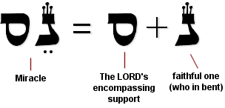
DIVINE PROVIDENCE
THE MONTH TO ENTER INTO A NEW LEVEL OF TRUST AND SUPPORT!

Slide 5
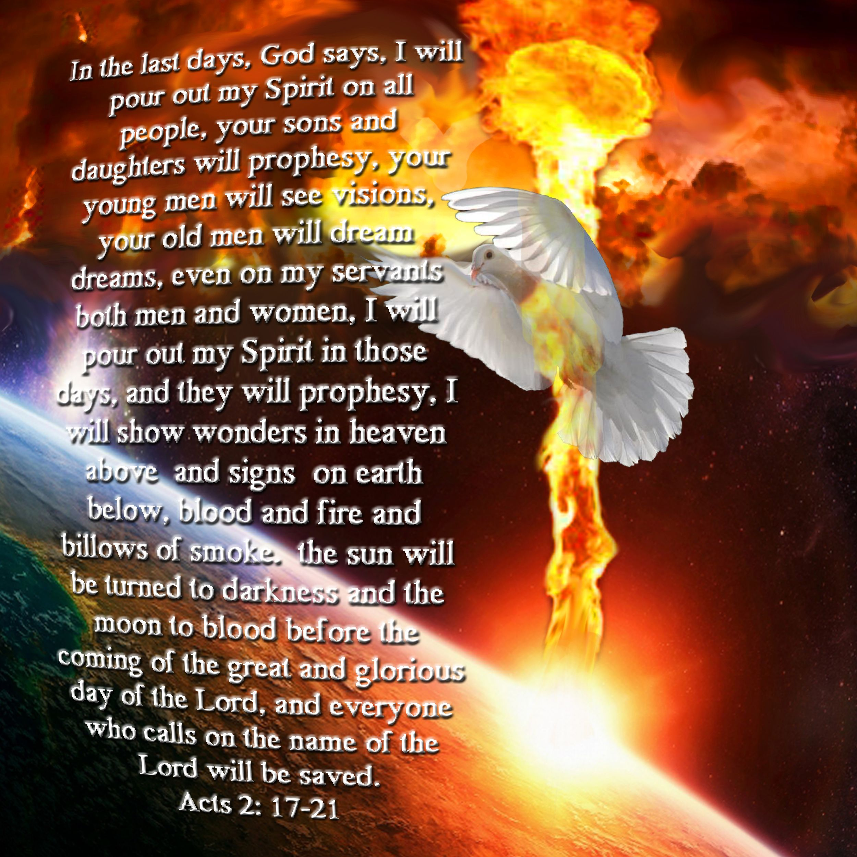
THE MONTH OF VISIONS AND DREAMS

Slide 6
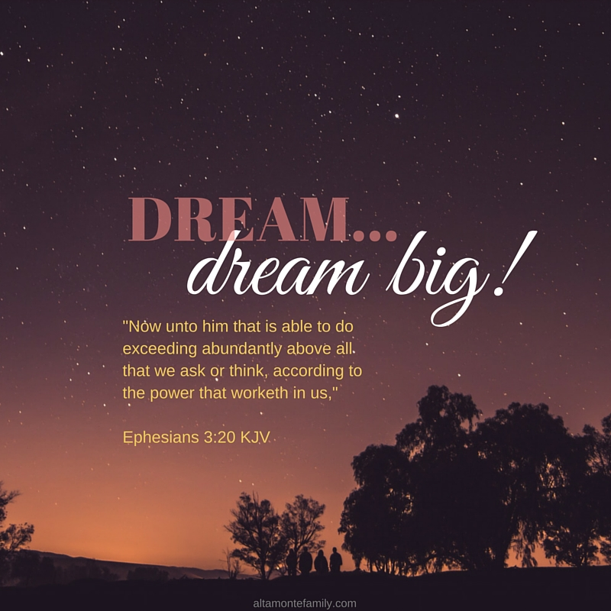
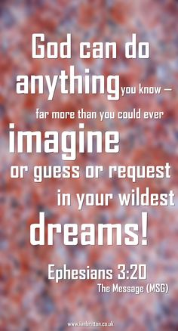

Slide 7
PSALM 126:1-3 When the Lord brought back the captives to Zion, we were like men who dreamed. 2 Our mouths were filled with laughter, our tongues with songs of joy. Then it was said among the nations, "The Lord has done great things for them." 3 The Lord has done great things for us, and we are filled with joy.

Slide 8
Psalm 126:4-6 Restore our fortunes, O Lord, like streams in the Negev. 5 Those who sow in tears will reap with songs of joy. 6 He who goes out weeping, carrying seed to sow, will return with songs of joy, carrying sheaves with him.

Slide 9
RESTORATION FULL RECOVERY
OT:2492 chalam — to dream
1) to dream (ordinary)
to dream (prophetic)
2) to be healthy, to be strong
a) to be healthy
b) to restore to health

Slide 10
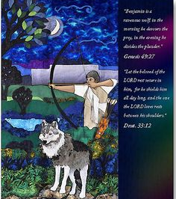
TRIBE: BENJAMIN
THE MOST GIFTED WITH THE ART OF THE BOW.
THE ONLY CHILD BORN IN THE PROMISE LAND.
THIS IS A MONTH TO WATCH ISRAEL.

Slide 15
Deut 33:12
About Benjamin he said: "Let the beloved of the Lord rest secure in him, for he shields him all day long, and the one the Lord loves rests between his shoulders." NIV

Slide 16
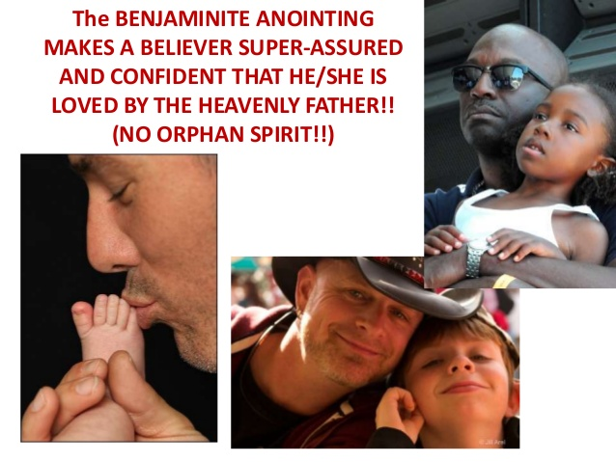
THE GOODNESS OF THE FATHER

Slide 17
BENJAMIN: RAVENOUS WOLF

Slide 18
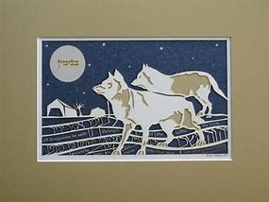

Slide 26
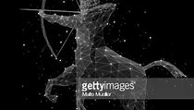
THE ARCHER A TIME TO FIGHT

Slide 27
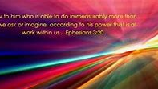
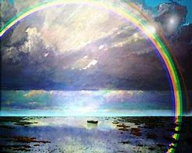
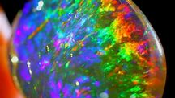
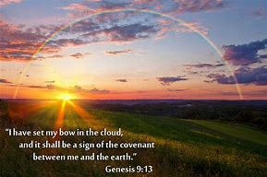
THE MONTH OF COVENANT
THE STONE: OPAL RAINBOW JASPER
THE STONE: OPAL RAINBOW JASPER

Slide 28
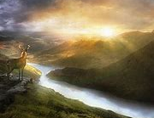
ASK FOR THE RIVER OF LIFE TO FLOW
A MONTH TO DECLARE:
YOUR LIFE EXPERIENCES TO BE FILLED WITH TRANQUILITY AND PEACE!

